Slide 1
Strategies in the Game of
Data Stewards vs. Data Hoarders
Keith Hartranft, CISSP Information Security and Policy Officer Library and Technology Services
Sara Rodgers Chief Information Security Officer Library and Technology Services

Slide 2
Playing the Wrong Game
Prioritize initiatives
Classify data
Analyze risk

Slide 3
Security Framework
SANS 20 Critical Controls
Objectives:
• Implement controls proven to block known attacks
ISO 27002 Policy Administration
Objectives:
To provide Management direction and support for information security in accordance with business requirements and relevant laws and regulations through Information Security Policy.
Security Awareness
Objectives of SETA:
• Integrate skills and competencies into a common body of knowledge
• Assess through proven metrics & testing
• Map specific actions to implement the controls
• Associate activities with NIST & NSA network security tasks
• Utilize procedures & tools for implementation and automation.
• Produce relevant and needed security skills and competencies
• Change behavior or reinforce good security practices
A Three Pronged Approach

Slide 4
Data Classification
Restricted Confidential
Government regulated (PCI-DSS, GLB, et al.)
Breach notification required
Examples: credit card number, social security number, driver’s license number, bank account number
Confidential
Government regulated (FERPA, HIPAA, GLB, et al.)
No breach notification required
Examples: grades, health care information, financial aid information, export control data
Institutional - Proprietary
Privacy, ethical or proprietary constraints
No breach notification required
Examples: Lehigh Identification Numbers (LINS), internal reports and memos
Public – Unrestricted
Protected at the discretion of the department or data owner
Examples: directory information, documents for public distribution
Public - Unrestricted
Institutional - Proprietary
Confidential
Restricted
PCI-DSS
GLB
FERPA, HIPAA GLB

Slide 5
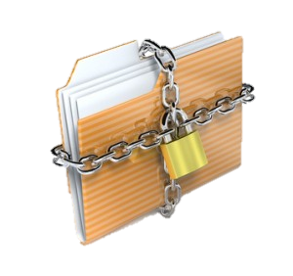
Measuring Risk
Reducing number of people records with restricted data
Collecting/storing restricted data on a large population with multiple copies and/or accessible by a large number of people
Likelihood/Probability
Reducing storage locations or limiting access
Removing or redacting restricted data
Severity/Impact

Slide 6
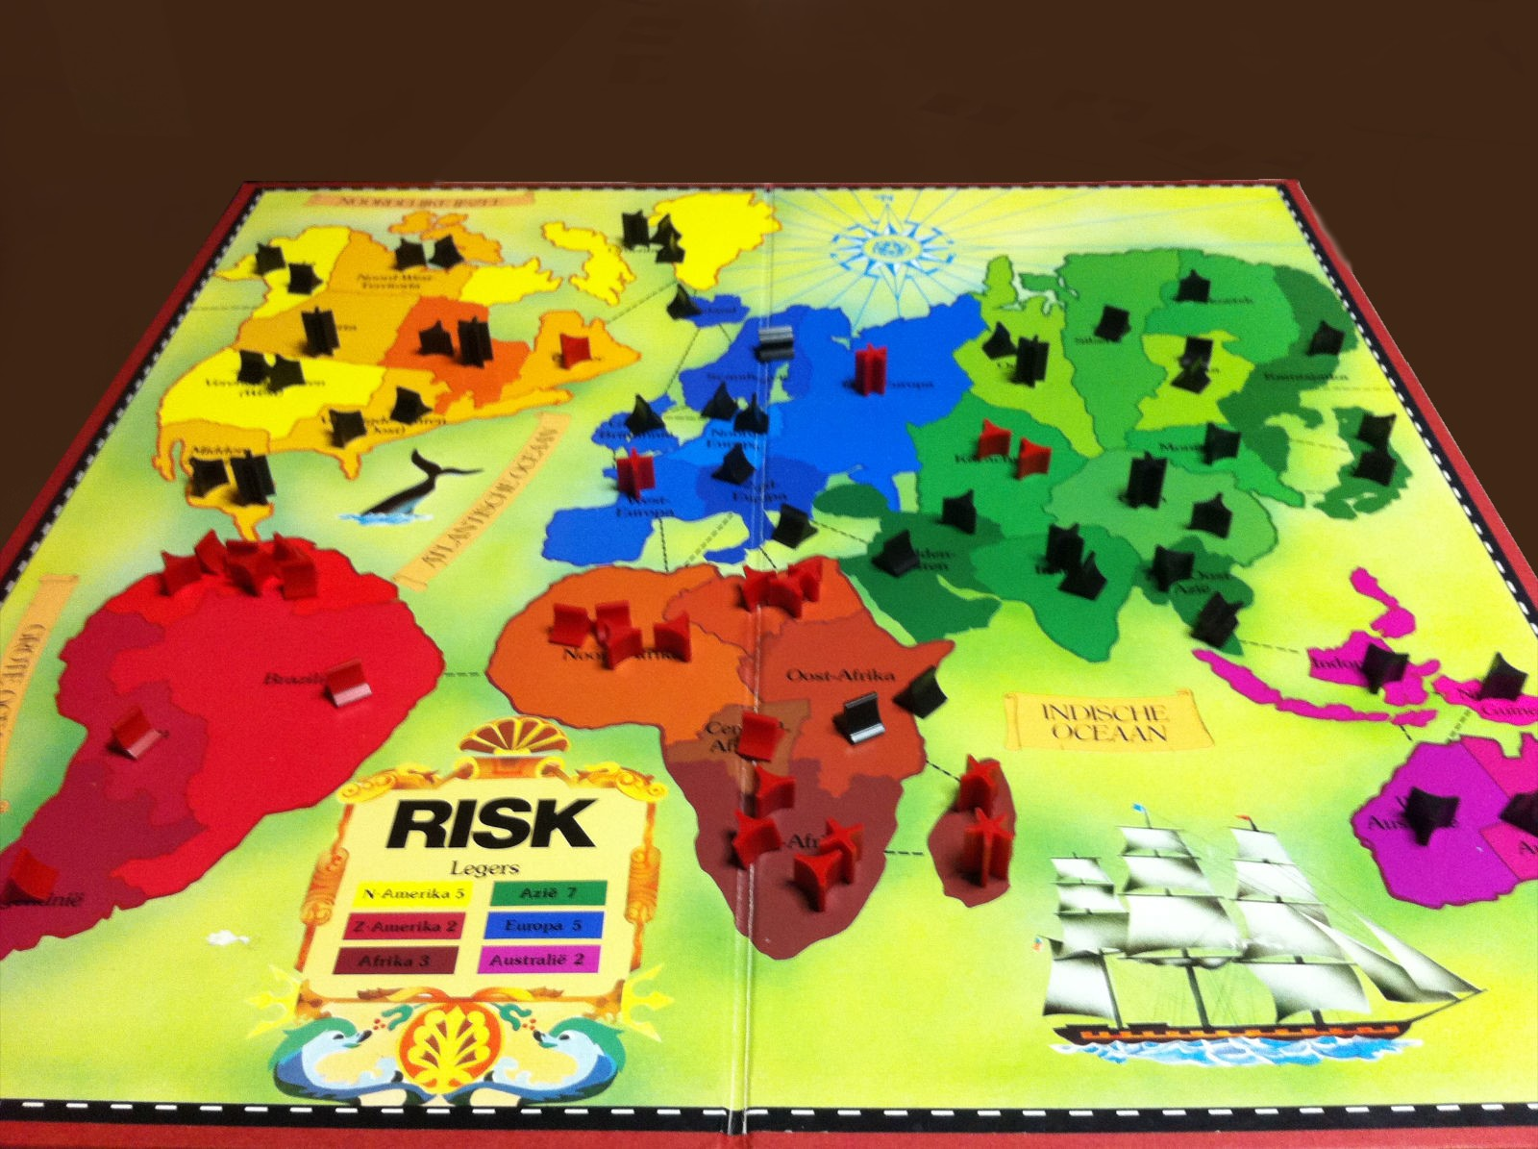
Knowing the Board and the Rules
Laws
Regulations
Asset Valuation & Risk
The Players

Slide 7
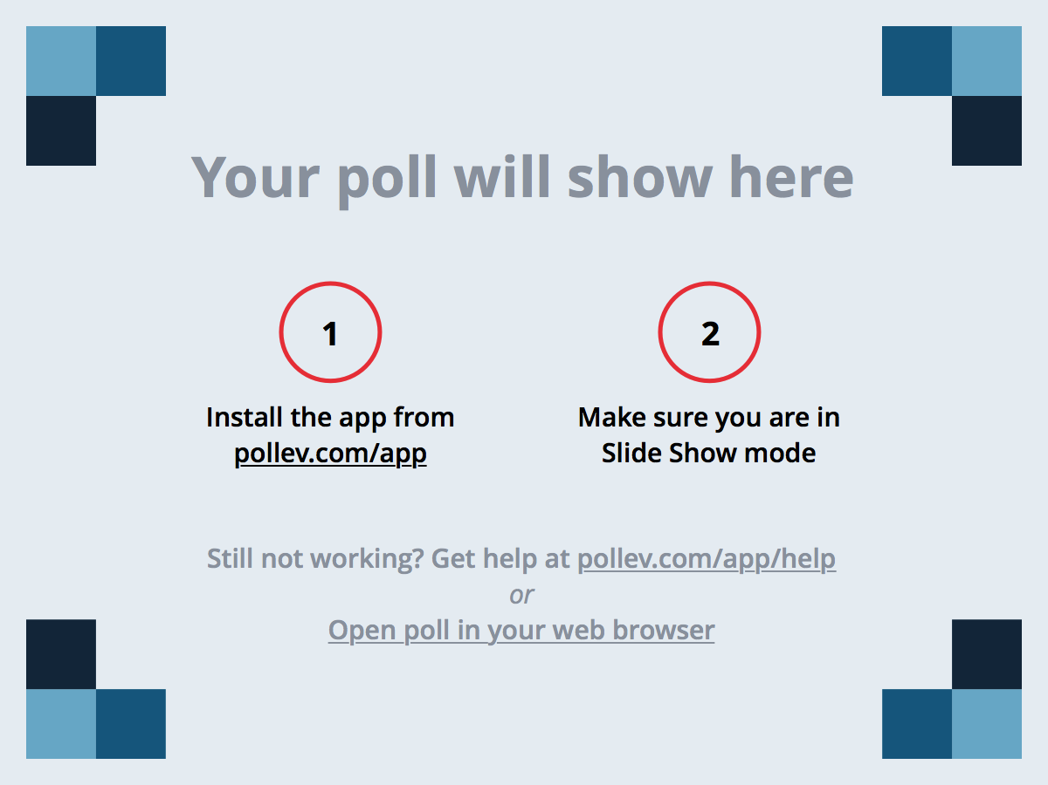
Notes:
Poll Title: What game would you say your Information Security Team is playing? http://www.polleverywhere.com/multiple_choice_polls/BEUr0RF8gr00IqY

Slide 8
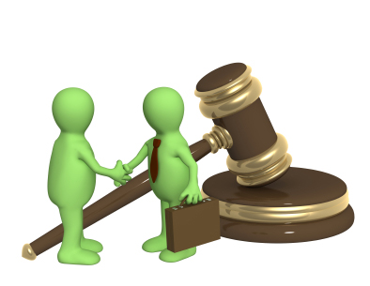
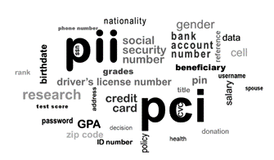
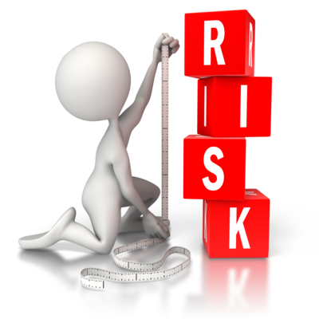
Information Security
Legal
Data User
Remove
Redact
Restrict
Risk Reduction
Risk Management
Data Custodians
Executives

Slide 9
The Strategy of the 3 R’s
Remove – Do we even need to collect it? Or can we dispose of?
Redact – If we store it, can we redact or obfuscate?
Restrict – Who should see it? Access it? What views?

Slide 10
Security as the Ambassador
Be the liaison in the process of Data Risk Reduction
Remove
Redact
Restrict
Risk Reduction
Data Hoarder
Data Stewards

Slide 11
ROCK - The Process
R. – Recruit the appropriate team(s) members
O. – Organize Assets, Policies, and Possible Solutions
C. – Communicate with the Data Users
K. – Kickstart the process with Quick Wins!
Data Stewards

Slide 12
Recruit - Build Your Armies
Legal
Governance
Regulation
Compliance
Committee (GRC)
Data Users
Risk Management
Data E-Security
Data Custodians
Executives

Slide 13
Notes:
Poll Title: What governance groups do you have at your institution? http://www.polleverywhere.com/multiple_choice_polls/0xsYqVXqEjbfdQs

Slide 14
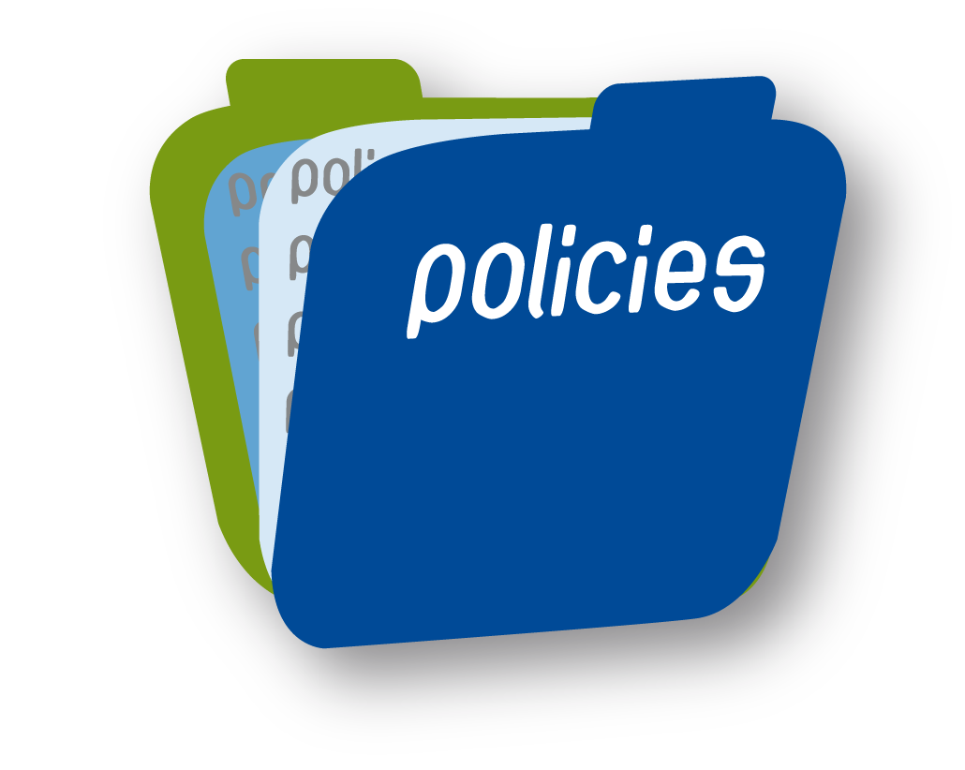
Organize - Arm Yourself With Policies
Data Classification
Retention Policies
Other?

Slide 15
Data Classification
Restricted Confidential
Government regulated (PCI-DSS, GLB, et al.)
Breach notification required
Examples: credit card number, social security number, driver’s license number, bank account number
Confidential
Government regulated (FERPA, HIPAA, GLB, et al.)
No breach notification required
Examples: grades, health care information, financial aid information, export control data
Institutional - Proprietary
Privacy, ethical or proprietary constraints
No breach notification required
Examples: Lehigh Identification Numbers (LINS), internal reports and memos
Public – Unrestricted
Protected at the discretion of the department or data owner
Examples: directory information, documents for public distribution
Public - Unrestricted
Institutional - Proprietary
Confidential
Restricted
PCI-DSS
GLB
FERPA, HIPAA GLB

Slide 16
Data Retention Policy
Attributes of a Good Retention Policy:
Value Based
Clear goals for retention and accountabilities
Defined Categories of Data
Properly vetted with cross functional buy-in by the community
Directs technology to support lifecycle sustainability
Includes monitoring and compliance

Slide 17
Communicate - the Strategy of the 3 R’s
Remove – Do we even need to collect it? Or can we dispose of?
Redact – If we store it, can we redact or obfuscate?
Restrict – Who should see it? Access it? What views?

Slide 18
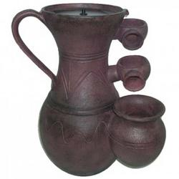
Communicate - AND I MEAN IT!!!
Remove – Can simply remove it or do without?
Redact – Who should be able to view it?
Restrict – Who should access it? And HOW?
Examine a “Fountain” effect.
What are some consequences?

Slide 19
Communicate – How to Comply With Data Retention
Bring Strategies for Storage solutions
Being a GOOD Steward – Disposing of Data Properly
Know your Retention times
Treat E-records like paper records

Slide 20
Communicate – Once We Reach Restrict, Protecting Access Controls
76% of breaches were the result of weak or stolen account credentials
What’s the cost? Approx. $200 per record.

Slide 21
Communicate with the Leaders and Troops
Meet with the Data Stewards and Users and pitch the steps and the consequences and results of each step
Do your homework for proposals regarding what you think are “Quick Wins” and ask others to identify other “Quick Win” areas.
Explain that greater Access Controls implemented by InfoSec are often the result of exhaustion of the first 2 R’s

Slide 22
KICKSTART! - Go for QUICK WINS!!!
Propose some key targets for data removal
Ask your Stewards to identify “Quick Wins” or Gains
Monitor and maintain momentum for proposed projects

Slide 23
KICKSTART! - QUICK WIN Stories!
F&A Review of Data Repositories
PII in more globally viewable locations removed
Duplicated Data in Test instances reduced

Slide 24
Deploy the Custodians - Technology
Automating scans and searches for records dates
Automated purges
Provide end user tools
Deploying data redaction or access control limitations
MFA

Slide 25
Sustain Your Strategy – ROCK(S)?
Repeatable processes
Review technology tools for process automation
Revist timelines and record schedules
Report annual records counts and reductions

Slide 26
Notes:
Poll Title: Where would you say your Data Users and Institution fall on the scale of Data Hoarder vs Data Steward? http://www.polleverywhere.com/multiple_choice_polls/QZ4nkjegxxLksKs

Slide 27
WIN!!! With Strategies in the Game of

