Slide 1
Recruiting and Identity Management
This presentation leaves copyright of the content to the presenter. Unless otherwise noted in the materials, uploaded content carries the Creative Commons Attribution-NonCommercial-ShareAlike license, which grants usage to the general public with the stipulated criteria.

Slide 2
About Speakers
Chris Green, Director, Information Security Services
Formerly Security Architect at UAB
Current CISO at Georgia State
Client Services (desktop, helpdesk, classroom, AV, labs)
Scott Fendley, Information Security Manager at UAB

Slide 3
Background
2010 Hire - Director, Quality Assurance in Provost Office
Focus on improving student experience
Common Support Issue: What ID do I use to login to this system?
Identity Management System Replacement Project (ongoing discussions)

Slide 4
Systems in Play
Hobson’s Connect Recruiting Profile (myUAB)
Hobson’s Events (Campus Tour)
Undergraduate Application
Banner Self Service
UAB BlazerID (homegrown IDM in flight to Oracle IDM)

Slide 5
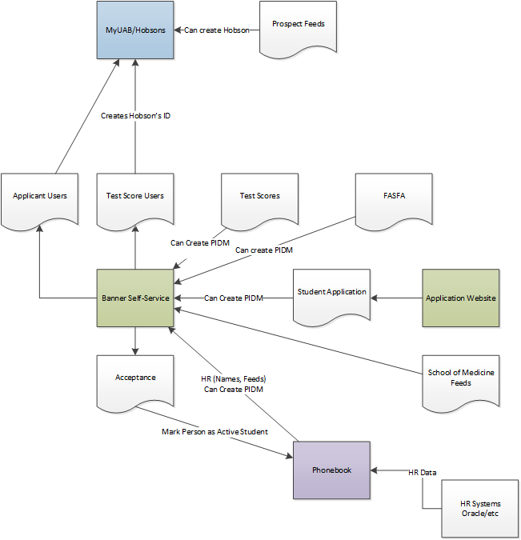
Data Integration Overview

Slide 6
Challenges
Duplicate Records
Three userids and passwords
Mailed Invites for Prospects (Come to our school!)
Changing User IDs – out of scope
Graduate Schools – out of scope

Slide 7
User IDs and Passwords
Hobson’s Connect – Recruits “ You might want to come here”
Banner SSN + PIN – Financial Aid, Admission Status “You must be really interested”
BlazerID Central – “Welcome to UAB, you need a username and password”

Slide 8
Mailed Invitations
Recruiting and matching up people to the invited record
Tracking what cohorts come to school
Avoiding recruiting people you’ve rejected!
School Fairs

Slide 9
Duplicate Records
What user id do I use? No worse than it is now!
Duplicate Checking
Banner – SSN match, Custom Common Matching, Manual Duplication
Hobson’s Connect – Custom rules, preferring “last established”, manual review (e.g. same password!)
Employment Systems (4 HR feeds – SSN Based)
Student Application (SSN optional)

Slide 10
The Plan
Do Integration
Do Testing
Clean it up
Go to Production

Slide 11
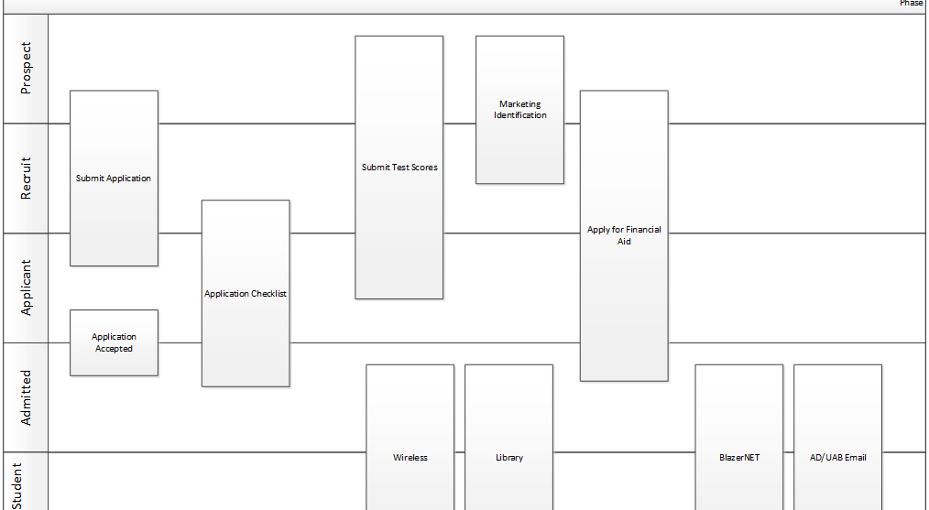
Roles

Slide 12
Implementation
Hobson’s Connect VIP Autologin
Custom registration form for Banner
Same BlazerID registration
User Registration for Application
Testing December 2011
Looking good, feeling good! Ugly and needs style

Slide 13
Rut Roh!
Hobson’s Events module is implemented by department
Timing: two weeks before go-live
Communication breakdown: “We didn’t think it would impact”

Slide 14
Break
API was logging in and completing profile in VIP
Events was a vendor acquisition
Vendor had no SSO API to Events
Events are more complicated than a registration
Don’t get in the way of a campus tour
Project suspended

Slide 15
Ongoing Hobson’s Calls
IT > Department > Vendor Contact > Vendor PM > Vendor Engineering
We need that feature
Designed without deep integration in mind
What do you need that to do? We will do that X?

Slide 16
Feature previews and pains
Would only work for using built-in Hobson’s ID system
Wouldn’t support SSO for existing people
API-only events “We don’t want to re-write a front end!”

Slide 17
An Observation and Push
August 2013
Watched an end-user try to use the system
Went around and told this story to everyone that would listen
CIO
AVPs in IT
Provost’s Office
Identity Management Team
Banner Team

Slide 18
Vendor Push and Delivery
Another round of calls
Finally, API delivery and commitment to fix scenarios

Slide 19
Team Back together!
Functional organization completely restructured
Student Issue Service Desk in place (OneStop)
Explain all the issues and how we thought we were solving them
Dust off the duplicate user id issue and convincing
Support

Slide 20
Implementation #2
IDM has changed some
Banner has changed some
Team has changed a lot!
Passwords Standards
QA cycle / Completion before IDM project has to start – January 2014

Slide 21
QA Look/Feel
Pre-Admit Support still done at the OneStop
Support plan has to be developed
AskIT support Post-Admit.
Handoffs for “reset BlazerID” scnearios
Testing
Testing
Testing

Slide 22
Go-Live November 2013
Browser Issues
Not knowing clearly what part was causing problem for user (Banner v. Hobson’s v. IDM)

Slide 23
Post-Go Live
Notes:
Mid Jan – Not meeting goals for admits
Complaints about passwords (Password Standard went into effect)
Better Error Messages on Passwords

Slide 24
Challenges
Labor resources
No Test Instance from Hobson’s
A/B Testing is very difficult
Increasing Friction at Student Application
Browser compatibility in a multi-product integration
Supporting Integrations between departments
Duplicates
Namespace

Slide 25
Ongoing Benefits
Single User ID and Password (starts expiring once they are at UAB)
Duplicates reduced
More people learned how the whole system works
More Secure! Hobson’s password correlation

Slide 26
Lessons Learned
Persistence pays off (on important things)
Big things can happen between “strategy”
Scenario documentation helps
Don’t expect anyone to read it
Little changes in functionality have big impact
http://www.uab.edu/students/undergraduate-admissions/

