Slide 1
HuskyHunt: Gamifying Security Awareness for Students
Jason Pufahl
@jasonpufahl
CISO – University of Connecticut
May 8, 2014

Slide 2
How do you deliver Security Awareness training to students that is:
          meaningful,
          interactive,
          fun, and
          repeatable?

Slide 3
HuskyHunt: Security Awareness Training for Students
      innovative
      interactive
      online game
      use computer or mobile device
      earn points & win prizes

Slide 4
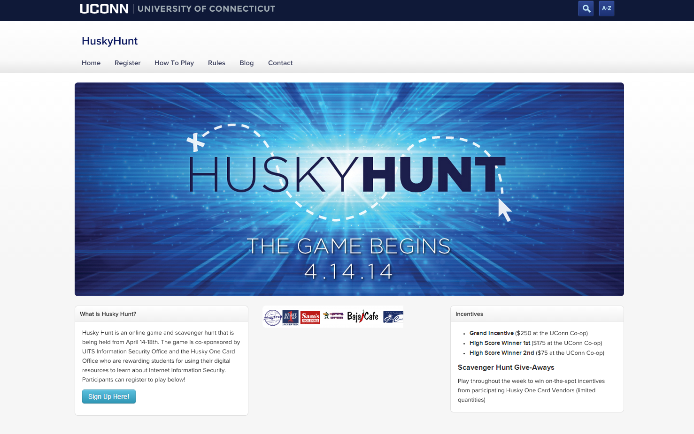
Huskyhunt.uconn.edu

Slide 5
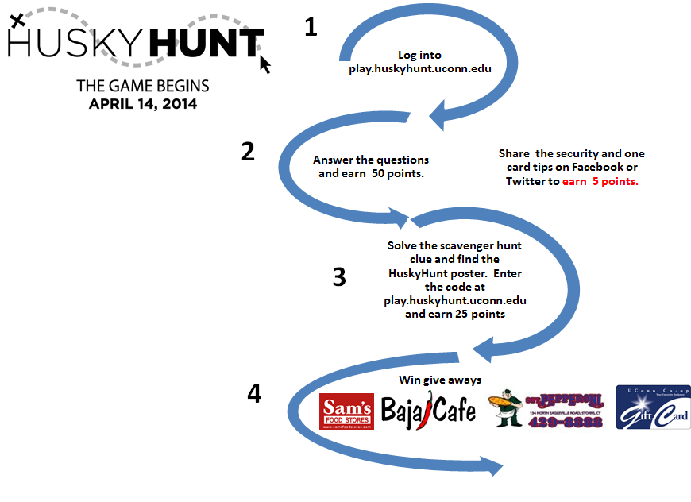



Slide 6
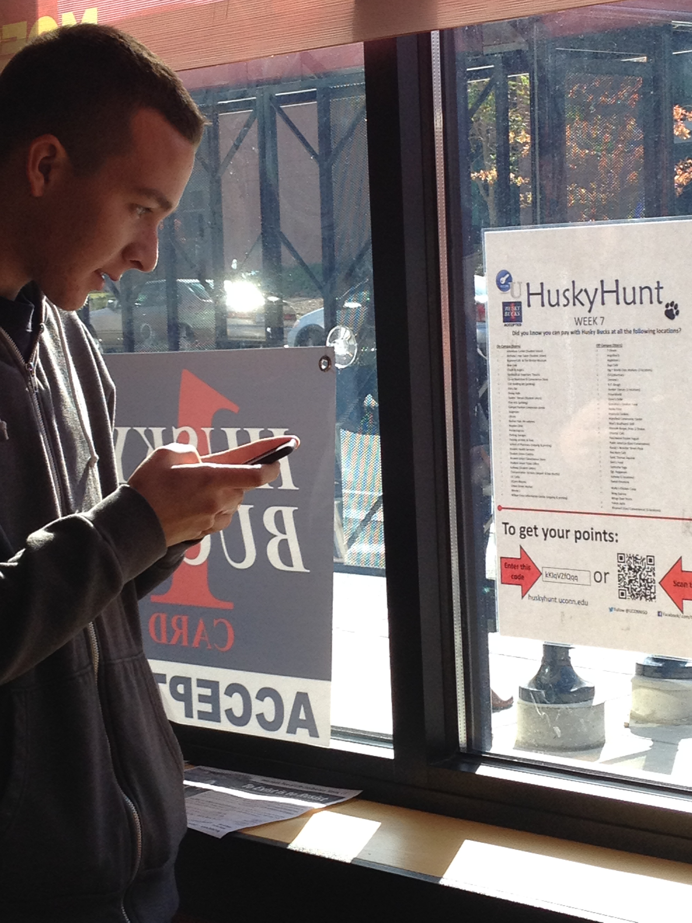
Locate poster
Player scans or enters code for points

Slide 7
Security Topics Covered
PII &
Spyware
vPC
Usage
Antivirus
Internet & Social Media
Password Complexity
Password Protection
Software Piracy
e-Commerce Safety
Phishing

Slide 8
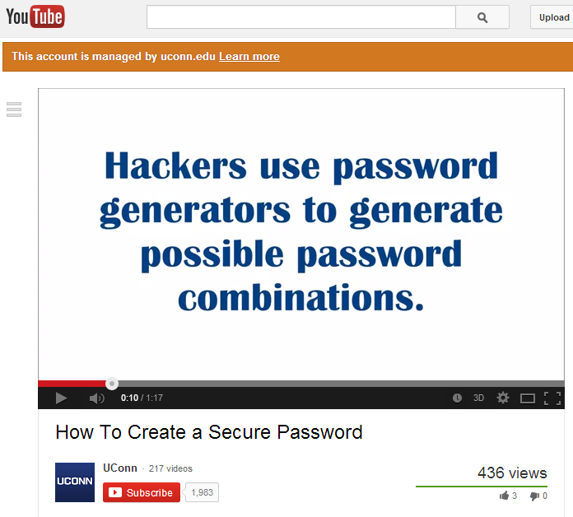

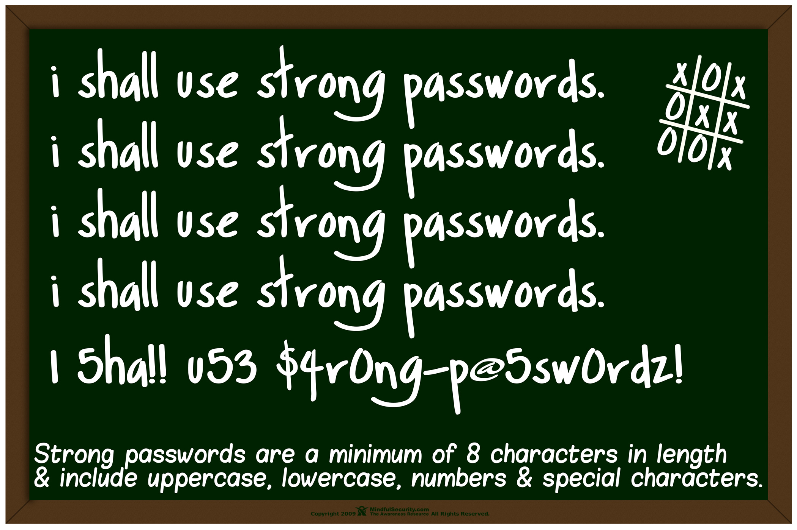
Content is Concise and Engaging
Strong Passwords are Long and Complex. #UCONNHUSKYHUNT

Slide 9


Partnership
Husky One Card Office
Student Digital Media

Slide 10







Incentives
Weekly give-aways from Husky One Card vendors:
Majority of vendors would participate again
3 Grand Prizes:

Slide 11
Marketing Strategy
Faculty/Staff/Student Listserv
UConn Homepage
UConn Events Calendar
Campus Newspaper
Semester Involvement Fairs
Dining Services Table Tents
University Bookstore (ads on registers)
    Student Union Movie Theatre Screen Advertisements
    UConn Radio PSA
    Stall Street News
    Shuttle Buses
    Student Union Bulletin Boards
    Student Union Tabling

Slide 12


Slide 13
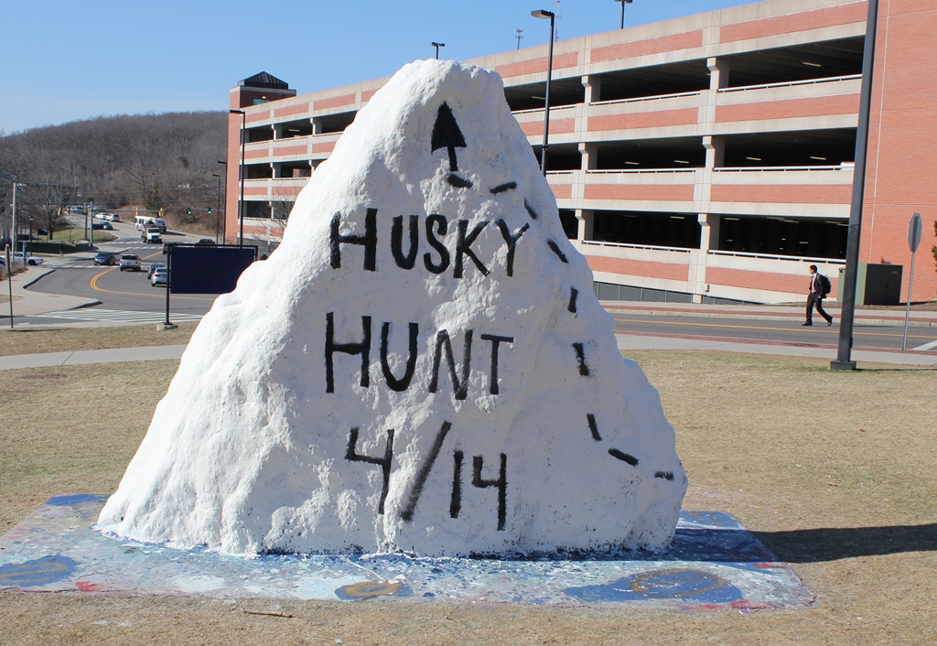
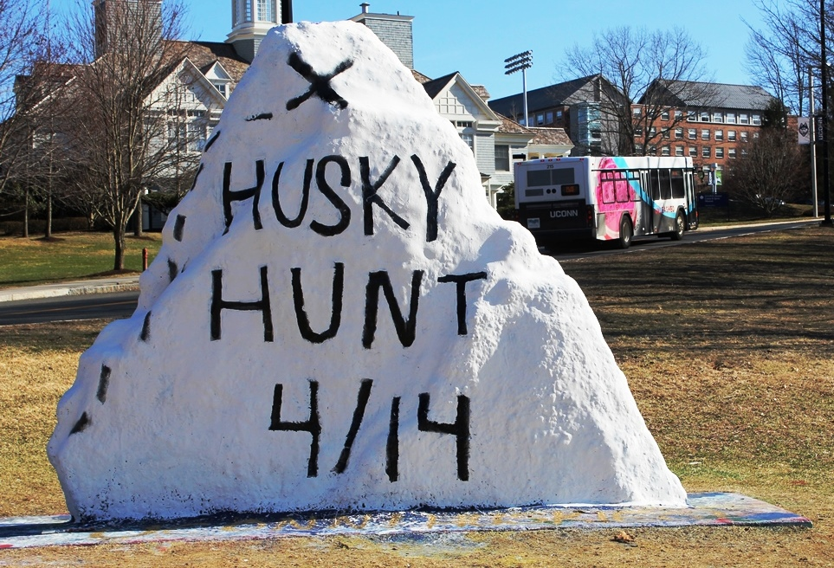

HUSKYHUNT makes it to the UConn Rock for one precious day.

Slide 14
Future Marketing Ideas
  Digital Media Class Project
  Freshman Year Experience
  Senior Year Experience
  Greek Life
  Department of Computer Science & Engineering- Targeted Department Listservs
  Residential Life/Hall Directors
  Army ROTC

Slide 15
Player Demographics

Slide 16
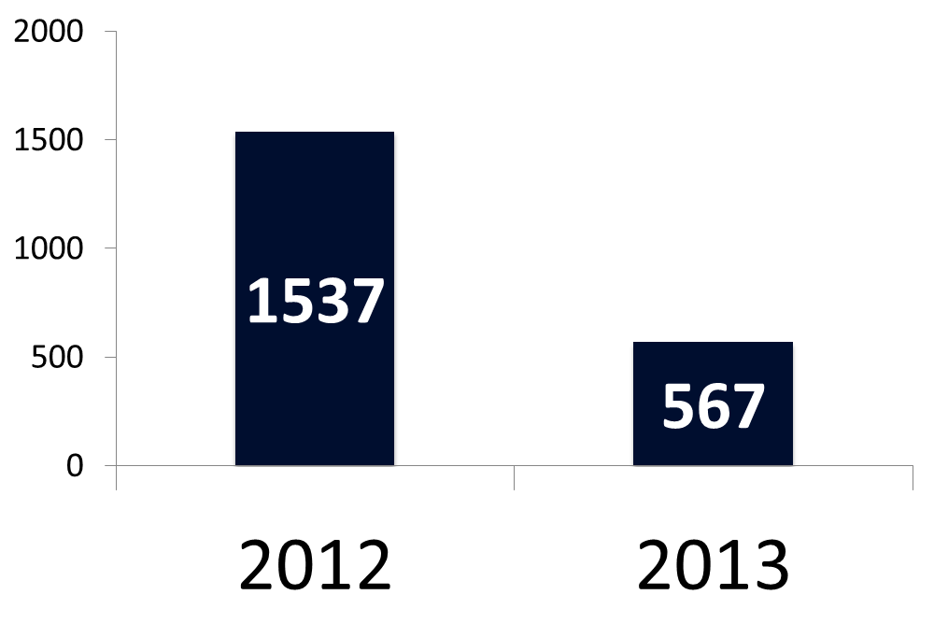
Enrolled Players

Slide 17
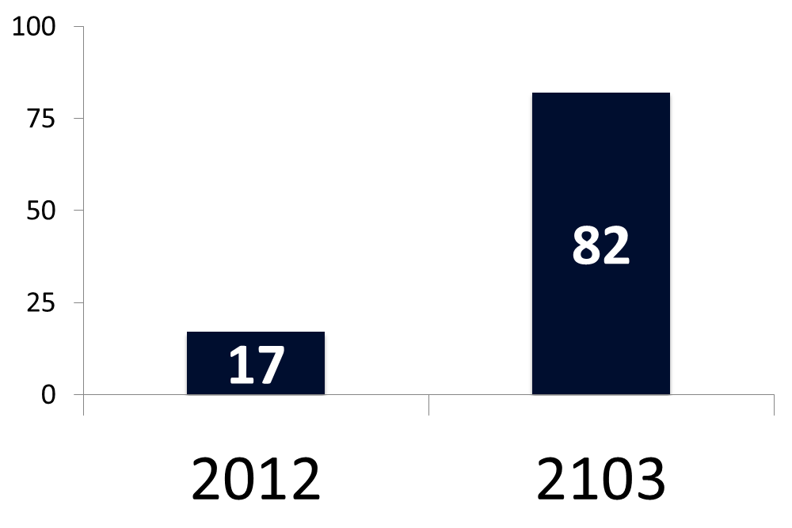
# of Players Eligible for Grand Prize

Slide 18
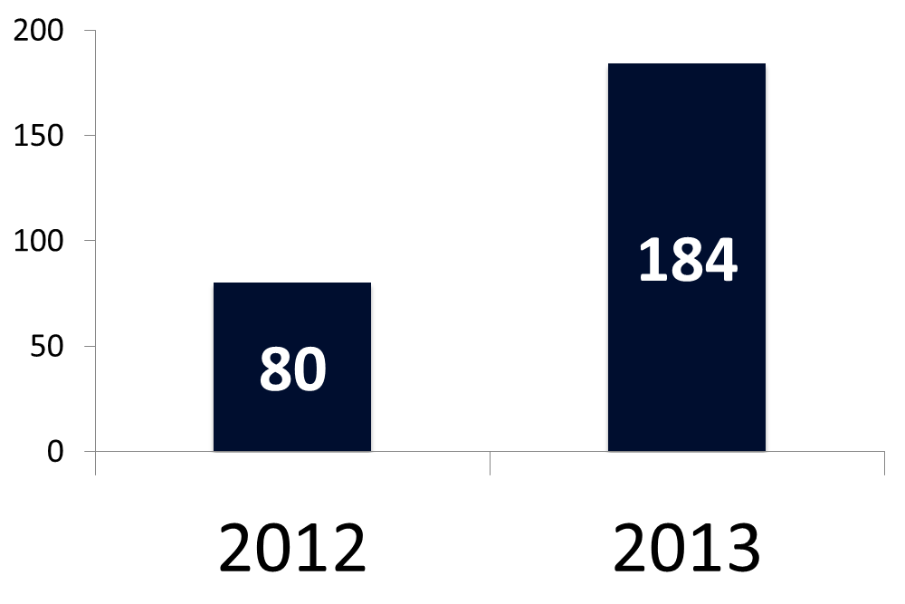
Played 1 or More Learning Modules

Slide 19
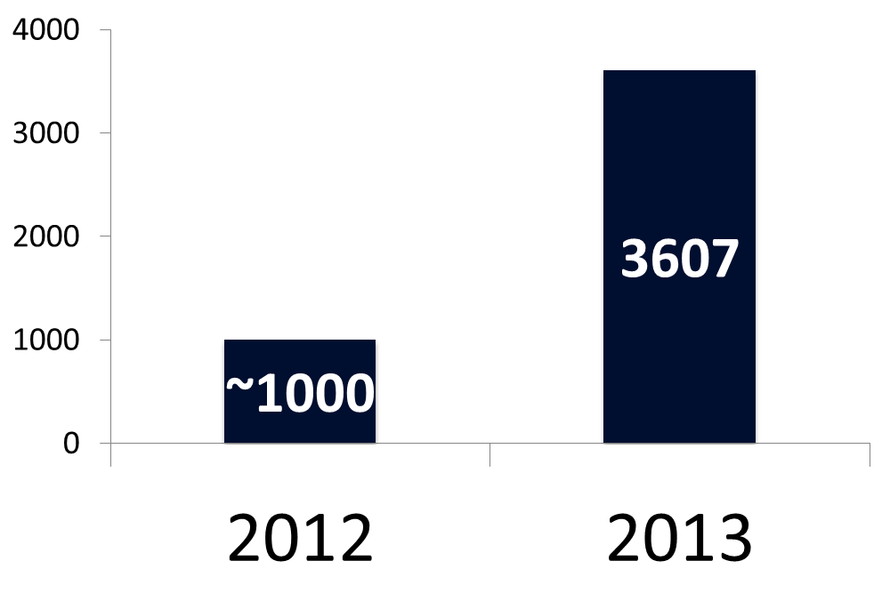
# of Posts and Tweets

Slide 20
Participation Metrics

Slide 21

Social Media Reach
Average # of Followers (age 18-21) = 200

Slide 22

Social Media Reach
6 Week Game
7360
184
200
184 * 200 * 0.2 = 7360
184 * 200 = 36,800
Players Posting to Social Media
Average # of Followers
Potential Reach

Slide 23


Slide 24
HuskyHunt 2014
One-week Game
Giveaways on Monday, Wednesday, Friday
319 tweets/facebook posts
316 registered users
181 active users (played 1 or more modules)
50 players eligible for prizes

Slide 25
Social Media Reach
1 Week Game
7240
181
200
184 * 200 * 0.2 = 7240
184 * 200 = 36,200
Players Posting to Social Media
Average # of Followers
Potential Reach

Slide 26
What Went Well?
Partnerships with One Card Office and ATION (Student Program)
Growth in # of Active Players
More Players Completing Modules
Matured Process- Administration and Implementation of Game

Slide 27
Future Plans
Run 2 Hunts per Year
Train Faculty/Staff
  Secure the Human/Use HuskyHunt as a Model for Delivering Security Awareness to Faculty/Staff
Multiple Campuses
Inter-University Competition (CHERIS)

Slide 28
How to Implement
GitHub.com/UConnISO/HuskyHunt
Future Wiki to Collect/Share Materials

Slide 29
Thank You!
Jason Pufahl
CISO jason.pufahl@uconn.edu
860.486.3743

