Slide 1
EPISODE I: USE THE FORCE
SENSITIVE INFORMATION IS POURING THROUGH THE FLOODGATES
WHICH SIDE OF THE FORCE WILL YOU USE?

Slide 2
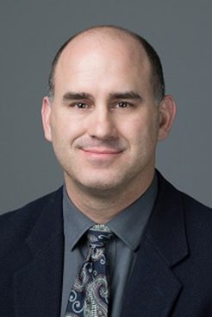
FROM A CAMPUS . . .NOT SO FAR AWAY
Forrest H. Swick
Information Security
University of Northern Colorado

Slide 3
EPISODE I: USE THE FORCE
THE GALACTIC REPUBLIC
– WITH TODAY’S BYOD ENVIRONMENT
– EVERYONE CARRIES A PERSONAL
• SMARTPHONE OR 2
• TABLETS
• LAPTOPS
• BLUETOOTH LIGHTSABERS
• THUMBDRIVES

Slide 4
EPISODE I: USE THE FORCE
– AND THEY DEMAND!
– SEAMLESS . . . EASY CONNECTIVITY
– TO THE CAMPUS NETWORK
• FOR EMAIL
• REPORT ACCESS
• PRINTING
• APPOINTMENT UPDATES
• BASICALLY . . . THEY NEED TO DO THEIR JOBS?
• AND OF COURSE WOOKIELEAKS…EPISODE IV
– WHICH BRINGS US TO . . .

Slide 5
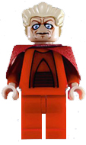
EPISODE I: USE THE FORCE
THE PLANET OF NABOO
– SENSITIVE INFORMATION IS AT RISK
– OUR SUPREME CHANCELLORS
• HAVE INFORMATION SECURITY NEEDS
• THEY KNOW THE RESPONSIBILITY LIES WITHIN
• AND NOT JUST ON INFORMATION SECURITY
• DON’T HAVE JEDI KNIGHTS TO DISPATCH
• DUE TO THEM BEING SITH

Slide 6
EPISODE I: USE THE FORCE
THERE IS NO PADAWAN (APPRENTICE)
– YET WE CAN
• CLASSIFY DATA
• DEVELOP GUIDELINES
• CREATE DATA HANDLING PROCEDURES
• HAVE EFFECTIVE AWARENESS TRAINING
– POLICIES ARE EVEN MORE CRITICAL!
• WE KNOW DARTH SIDIOUS IS BEHIND EVERY RISK

Slide 7
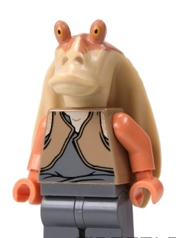
EPISODE I: USE THE FORCE
JAR JAR BINKS KNOWS
– MOBILE DEVICES ARE
• EASILY LOST
• THE TOP TARGET OF THIEVES
– THE DEFAULT SETTINGS
• NO PASSWORD
• NO PIN
• NO PATTERN LOCK

Slide 8
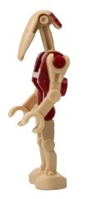
EPISODE I: USE THE FORCE
WITH THE BATTLE OF THE DROIDS
– MOBILE DEVICES HAVE
• OVER 8GB OF FREE SPACE
• INSECURE COMMUNICATIONS
• INFLATED APP PERMISSIONS
• IMPROPER APP SECURITY CONTROLS
– YET MANAGEMENT WANTS
• CAMPUS EMAIL ACCESS
• CLOUD APPLICATIONS AND ACCESS TO DATA
• IT FEELS AS IF EVERYONE FAVORS FUNCTIONALITY SECURITY

Slide 9
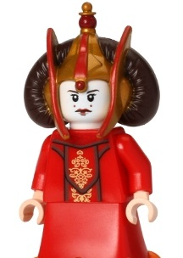
EPISODE I: USE THE FORCE
EVEN QUEEN AMIDALA
– CANT AFFORD TECHNOLOGIES
• TO SEE ALL THE RISKS
• TO STOP EVERY THREAT
– HER PERSONAL JEDI CANT
• STOP MOBILE DEVICE COMMUNICATION
• STOP CELLULAR PROVIDERS NETWORKS COVERAGE
– WHO CAN AFFORD ENOUGH SECURITY INFRASTRUCTURE?

Slide 10
EPISODE I: USE THE FORCE
ANAKIN SKYWALKERS OWN DROID
– C3PO – WAS BUILT FOR PROTOCOLS
• TO DEVELOP GUIDELINES
• TO CREATE POLICIES
• TO CREATE PROCEDURES
• TO CLASSIFY DATA
• TO BUILD AN INFORMATION SECURITY PROGRAM
– YET – WHAT IS MISSING?

Slide 11
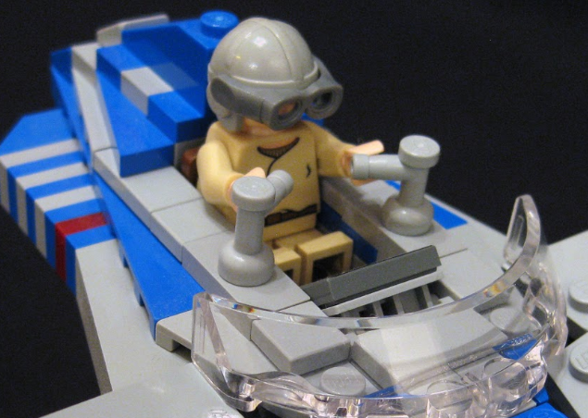
EPISODE I: USE THE FORCE
WIN A PODRACING TOURNAMENT?
– THIS WONT FREE YOU FROM
• COMPLIANCE REQUIREMENTS
• LEARNING ABOUT DARTH MAUL RISKS
• UNDERSTANDING SECURITY LITERACY
• NEEDING TO LEARN AWARENESS MINDTRICKS
– WHO IS THE CHOSEN ONE IN SECURITY?

Slide 12
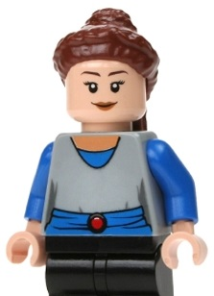
EPISODE I: USE THE FORCE
Padmé IS THE REAL QUEEN
– WHICH MAKES AWARENESS THE KEY*
• ON HOW TO CLASSIFY DATA
• ABOUT CAMPUS GUIDELINES
• ABOUT ESTABLISHED POLICIES
• ABOUT PROCEDURES
• ABOUT YOUR CAMPUS INFOSEC TEAM
– THIS IS THE JEDI MINDTRICK!
*sorry Charlie Miller . . .

Slide 13
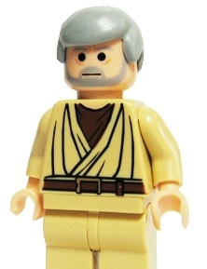
EPISODE I: USE THE FORCE
AWARENESS…THE JEDI MINDTRICK
– SUBTLY MAKE CAMPUS AWARE
• OF WHERE TO LOOK TO CLASSIFY DATA
• OF YOUR CAMPUS GUIDELINES
• OF YOUR ESTABLISHED POLICIES
• OF YOUR PROCEDURES
• OF HOW TO SELF IDENTIFY RISKS
– IT IS AS SIMPLE AS
• “THESE ARE NOT THE DROIDS YOU ARE LOOKING FOR”

Slide 14
EPISODE I: USE THE FORCE
AWARENESS…THE JEDI MINDTRICK
– IT IS NOT A LIGHTSABER DUAL
– DON’T TEACH SECURITY LITERACY
• WHAT IS A PHISHING ATTACK?
– DO TEACH SECURITY AWARENESS
• HOW TO SPOT A PHISHING ATTACK!

Slide 15
EPISODE I: USE THE FORCE
http://www.unco.edu/cybersecurity/faculty/Phishing.html
GENERIC EMAIL GREETING:
A typical phishing email will have a generic greeting, such as “Dear User.”
FALSE SENSE OF URGENCY
“Your account will be disabled if it’s not updated within three (3) business days!”
DECEPTIVE URL - http://signin.paypal.com@10.19.2.4/

Slide 16
EPISODE I: USE THE FORCE
AWARENESS…THE JEDI MINDTRICK
– DON’T . . . PUNISH BAD BEHAVIOR
– DO . . . REWARD GOOD BEHAVIOR
• IT SECURITY HERO OF THE WEEK AWARDS

Slide 17
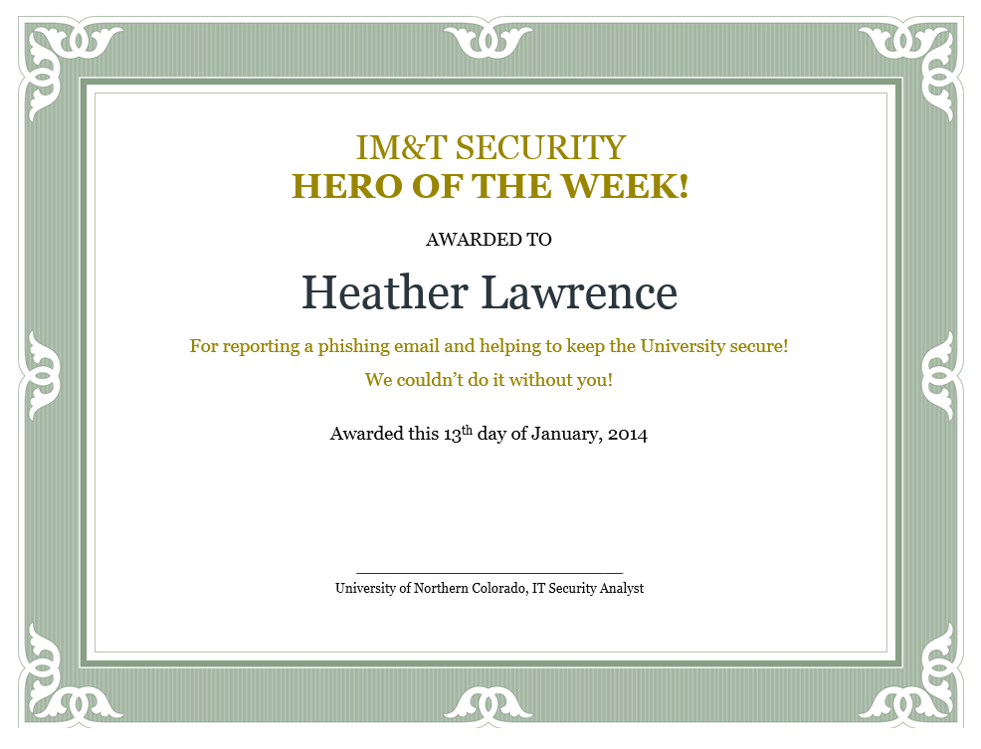
EPISODE I: USE THE FORCE

Slide 18
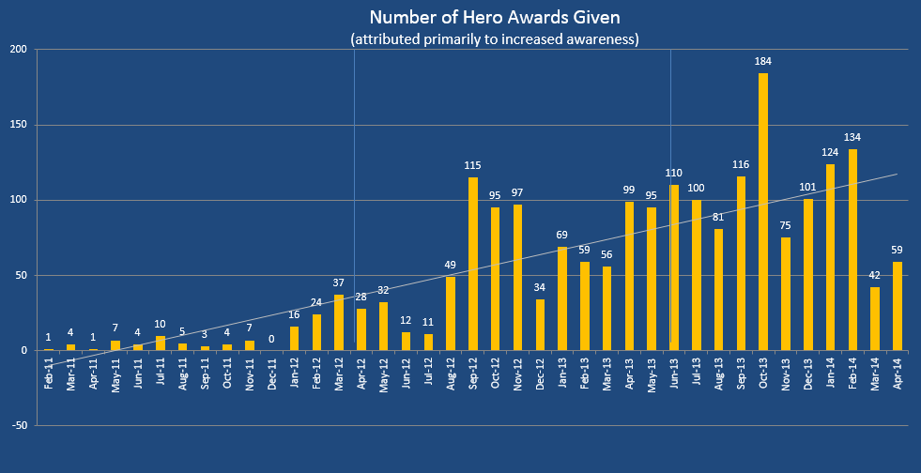
EPISODE I: USE THE FORCE

Slide 19
EPISODE I: USE THE FORCE
AWARENESS…THE JEDI MINDTRICK
– DON’T . . . TELL THEM HOW TO BE SECURE
– DO . . . SHOW THEM HOW TO:
• HELP OTHERS
• HELP THEIR KIDS STAY SECURE ONLINE
• HELP THEIR PARENTS SHOP SECURELY
• HELP THEIR ELDERLY NEIGHBORS
– MAKE OTHERS YOUR APPRENTICE

Slide 20
EPISODE I: USE THE FORCE
AWARENESS…THE JEDI MINDTRICK
– GET INVOLVED WITH CAMPUS EVENTS
• FALL STUDENT INVOLVEMENT FAIR (AUG)
• HEALTH AND SAFETY FESTIVAL (SEPT)
• NATIONAL CYBER SECURITY AWARENESS MONTH (OCT)
• NATIONAL DATA PRIVACY DAY (JAN)
• NATIONAL DATA PRIVACY MONTH (FEB)
• EARTH DAY – INFOSEC SHREDFEST (APR)
• STAR WARS DAY – MAY 4TH

Slide 21
EPISODE I: USE THE FORCE
AWARENESS…THE JEDI MINDTRICK
– AWARENESS ACTIVITIES
• GUEST SPEAKERS IN CAMPUS CLASSROOM
• BE AVAILABLE FOR FACULTY/STAFF TRAINING
• CREATE POSTCARDS/TABLE TENTS/GIVEAWAYS
• TARGETED MESSAGES (BLACK FRIDAY, TAX TIME TIPS)
• PUBLIC SPEAKING FOR GROUPS / CONFERENCES

Slide 22
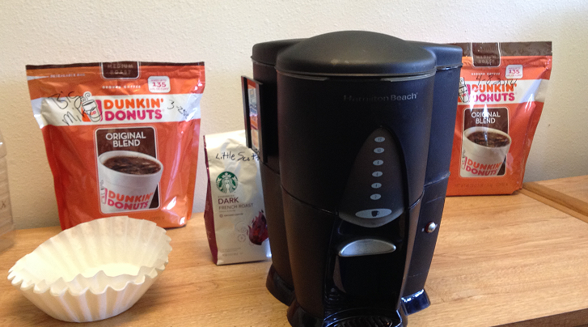
EPISODE I: USE THE FORCE
AWARENESS…THE JEDI MINDTRICK
– HOST THE DEPARTMENTAL COFFEE CLUB
• KEEP A HOT COFFEE POT ON
– GIVE OTHERS A REASON TO VISIT INFOSEC
• INFOSEC HAS A TENDANCY TO ISOLATE ITSELF
– BE AVAILABLE

Slide 23
EPISODE I: USE THE FORCE
AWARENESS…THE JEDI MINDTRICK
– USE THE EDUCAUSE RESOURCES!
• 2014 INFOSEC SECURITY GUIDES
• NETWORK WITH OTHER INFOSEC TEAMS IN YOUR AREA
• EDUCAUSE SECURITY LISTSERV
• JOIN REN-ISAC
– USE ALL THE TOOLS AVAILABLE TO YOU

Slide 24
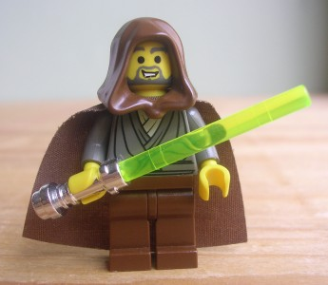
EPISODE I: USE THE FORCE
BE A SECURITY JEDI KNIGHT
– DEVELOP RELATIONSHIPS WITH
• DATA STEWARDS OUTSIDE OF IT
• THE REGISTRAR’S OFFICE
• HUMAN RESOURCES
• INSTITUTIONAL RESEARCH BOARD
• RESEARCHERS

Slide 25
EPISODE I: USE THE FORCE
BE A SECURITY JEDI KNIGHT
– WORK WITH YOUR LEADERSHIP
• TO CREATE EFFECT POLICIES
• TO CREATE EFFECT PROCEDURES
• TO ESTABLISH RULES TO CLASSIFY DATA
• TO BUILD AN INFORMATION SECURITY PROGRAM
• TO ADVOCATE AWARENESS
– WITHOUT CAMPUS INFOSEC AWARENESS
• YOUR DATA WILL FALL TO THE DARK SIDE

Slide 26
EPISODE I: USE THE FORCE
“FOR MY ALLY IS THE FORCE, AND A POWERFUL ALLY IT IS.” -YODA
AWARENESS IS YOUR ALLY, AND A POWERFUL ALLY IT IS.
*All copyrighted materials owned by the respective owners where applicable.

Slide 27
FROM A CAMPUS . . .NOT SO FAR AWAY
Q&A!
THANK YOU!
Forrest H. Swick
Information Security
University of Northern Colorado
forrest.swick@unco.edu

