Slide 1
The Athenaeum in Motion Project (AIM)
Explore the world in a whole new way
February 3, 2014
Benjamin M. Andrus and Juan Denzer

Slide 2
Project Origins
National Library of China
Prototype using Kinect as Newspaper Reader
Leap Motion crowd-funded

Slide 3
Our Project

Slide 4
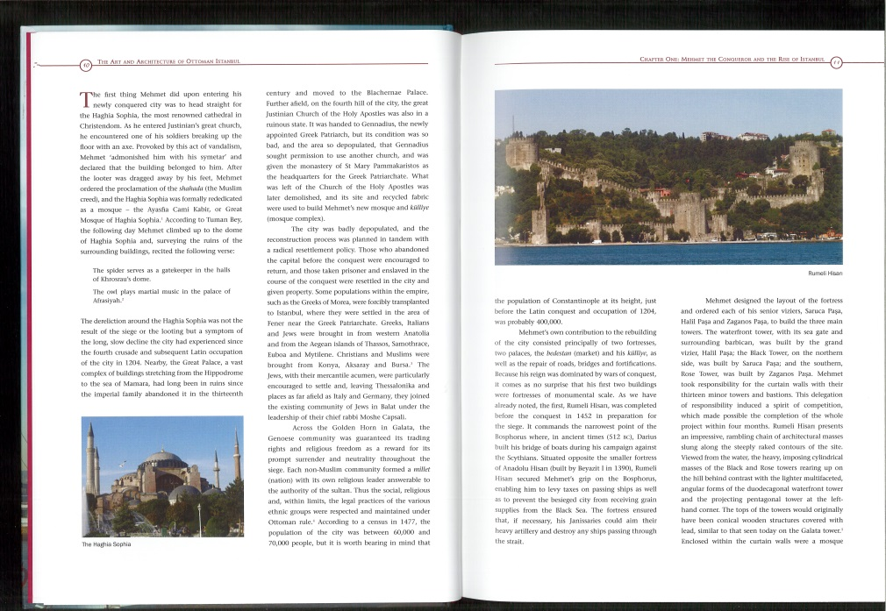
How it Works Start with Original Scans

Slide 5
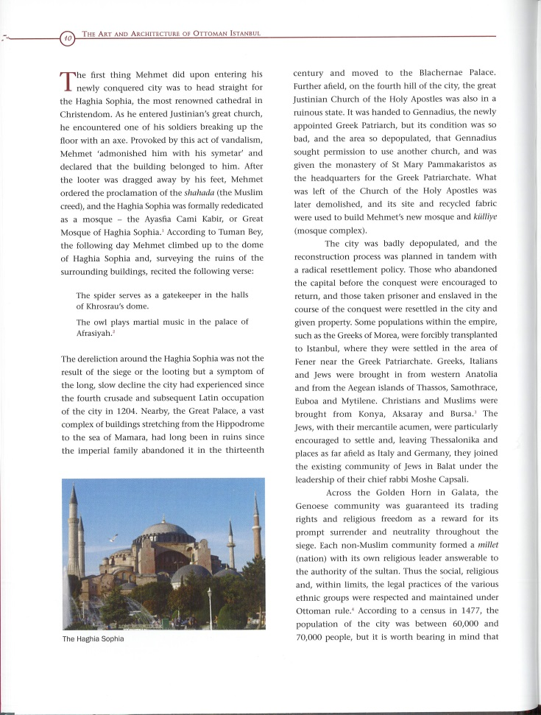
How it Works Crop Original Scans
Scans are in JPEG format

Slide 6
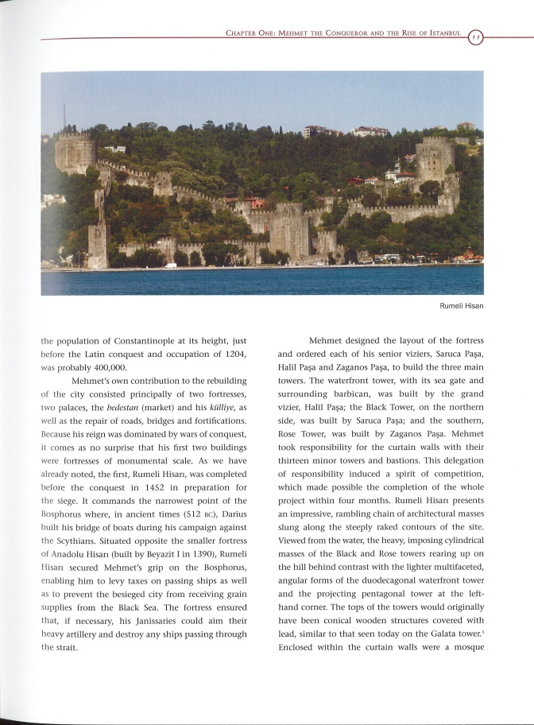
How it Works Crop Original Scans
Scans are place on a overlay of a blank book

Slide 7
How it Works Crop Original Scans
Scans are place on a overlay of a 3D book model

Slide 8
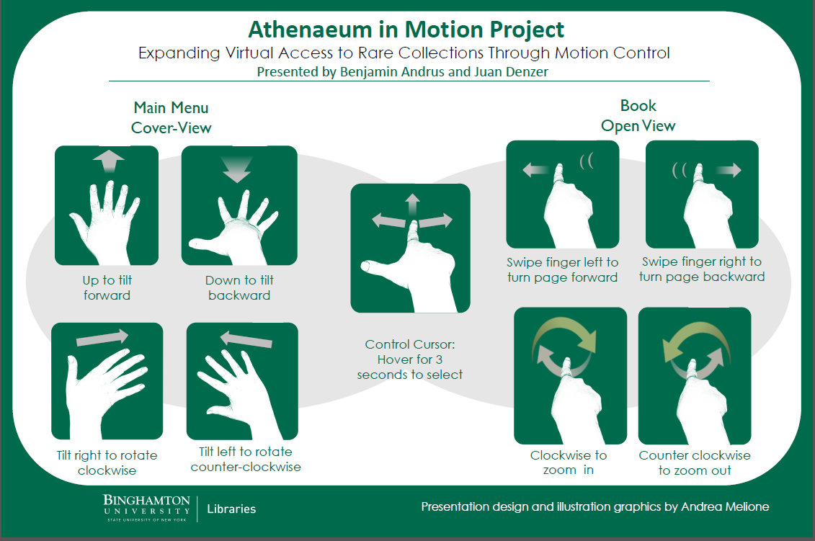
Leap Motion Hands-Free Navigation

Slide 9
Links
Initial Interactive Newspaper Flipbook
Simple Opening Book Animation
Initial Application using Kinect
3D Party Leap Motion Skull App Demo
Leap Motion
Microsoft Kinect

Slide 10
Contact Information
Juan Denzer
Library Systems Specialist
Binghamton University
jdenzer@binghamton.edu
607 777 3499
Benjamin M. Andrus
Assistant Librarian
Binghamton University
bandrus@binghamton.edu
607 777 4303

