Slide 1
Leveraging Collaborative Technologies and Pedagogies in Large Active Learning Classrooms Anastasia Morrone Greg Siering Indiana University

Slide 2
The beginning of the journey
The vision for the Collaborative Learning Studio grew out of a proposal from the departments of Geography and Anthropology together with the New Pedagogies New Technologies grant program.
This shared vision centered around holistic, transformative course/curriculum redesign, the use of innovative technologies, and the creation of a large, technology-rich, collaborative learning classroom.

Slide 3
What happened next?
.
CLASSROOM WANTED
New classroom space that can seat ~100 students. Must be technology-rich to support active learning in a range of disciplines.

Slide 4
First it was a swimming pool

Slide 5
And then it was a map library

Slide 6
And then construction began…
From: Young, Frank A Sent: Thursday, September 20, 2012 10:47 AM Subject: Floor Failure - Student Building 015 Project - 20117643 Importance: High

Slide 7
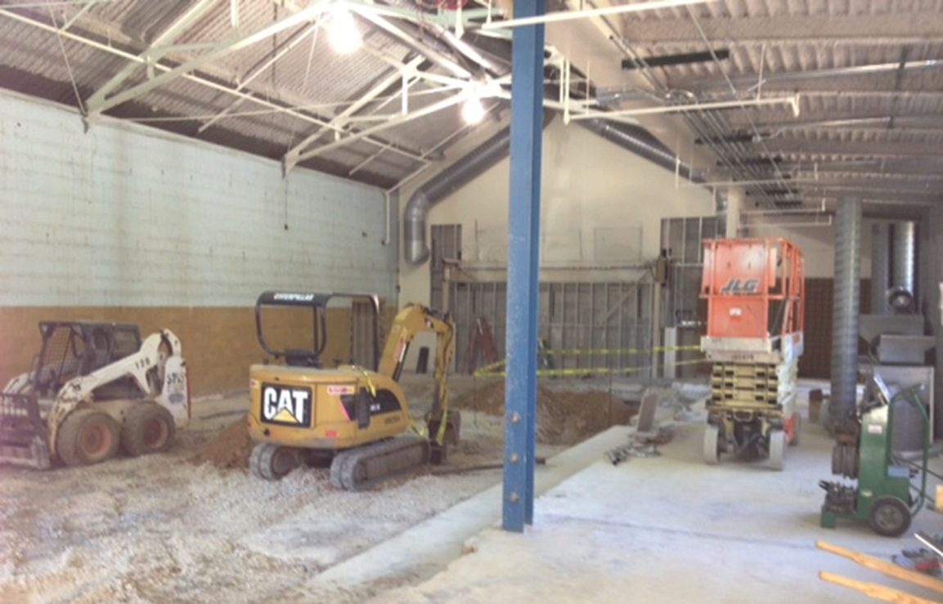
Mid-construction: Collapsed floor

Slide 8
Collaborative Learning Studio

Slide 9
Collaborative Learning Studio

Slide 10
Collaborative Learning Studio
The video wall is a 240" diagonal display with 16 60” Sharp PN-V601 monitors.
16 Spectrum student tables with built-in racks to house the PC and AV switching equipment and excellent wire management.
46” Samsung monitor at each student table.
35 total displays for content.
50 individual connections for student/faculty laptops.

Slide 11
Video wall display options
16 simultaneous student table displays (gallery view)
1 large image across the 16 panels (single view)
4 images (quadrant view)
Blank (no display)

Slide 12
Faculty and student experiences
Video available at http://www.youtube.com/watch?v=V--U83Zz8Do
Notes:
VIDEO EMBEDDED HERE

Slide 13
What do you think?
From what you’ve seen of this project, what do you think were the biggest benefits and challenges of this room for instructors?

Slide 14
Research Approaches
Student focus groups
First impressions
Typical days
Aesthetics
Group dynamics
Benefits / drawbacks of space
Learning in groups / learning with technology
Faculty interviews
Usefulness of the room
Benefits and drawbacks
Shifts in teaching (e.g., less content coverage)
What they’d like to see in the space
Teaching Background, esp. with collaborative learning

Slide 15
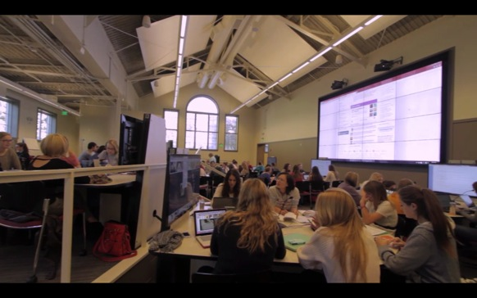
Research Findings: Faculty
Highly useful for collaborative learning in large classes
Group work attitudes/dynamics improved
Ability to project student group work is valuable
Class-wide sharing/discussion still difficult
More teaching assistant help is needed
Desire for more support (cohort and required)

Slide 16
Research Findings: Students
Initially intimidated by technology, but quickly adjusted
Natural light and spaciousness helped attitudes and ability to do group work
Appreciate the increased visual element of classes
High satisfaction with both stable and changing groups
Liked being able to work on projects in class, for both convenience and feedback
Seems to impact attitudes toward group work
Small groups work well; class-wide discussions difficult

Slide 17
Research Findings: Students
Students whose instructor didn’t utilize the space as intended reported that they were initially excited about the room, but felt disappointed as they realized their class would be conducted as if it were a lecture hall.

Slide 18
Ongoing Challenges
Helping instructors reconceptualize collaborative learning and “group work”
Providing mobile control solutions for instructors (e.g. Doceri)
Finding the right level of required training
Helping change guidelines on TAs
Appling lessons to less ambitious spaces

Slide 19
Suggestions for Ongoing Research?
What specific research questions would you have for this project moving forward?

Slide 20
Suggestions for Ongoing Research?
Impact on student learning in particular classes
e.g. GIS and coding in groups vs solo
Impact on faculty perceptions and practices of collaborative learning
Impact on student perceptions and practices of collaborative learning

Slide 21
For more information…
Anastasia Morrone
Associate Vice President, Learning Technologies, and Dean for IT
Indiana University
amorrone@iu.edu
Greg Siering
Director, Center for Innovative Teaching and Learning
Indiana University Bloomington
gsiering@indiana.edu

