Slide 1
Project Update & Plans for 2014
ECAR Mobile Strategy & Application Development (MSAD)
Rose Rocchio, UCLA, Chair of ECAR-MSAD
Lori Tirpak, Oakland University
January 28th, 2014

Slide 2
ECAR MSAD Mission
Develop & promote collaborative mobile strategies
Focused on device-agnostic requirements
Leveraging mobility for faculty, students, and researchers
Exploring methods to share mobile tool development
Projects will focus on the mobile space:
Mobile data collection and other related areas
Responsive Web Design
Mobile user experience and accessibility
Mobile development frameworks

Slide 3
Current Projects
Exploration of BYOD Mobile Data Collection
How a strategy of Responsive Design and Mobile Apps compliment one another
Strategic Briefing
Pre-conference seminar @ 2013 annual meeting

Slide 4
Mobile Data Collection (MDC)
Passive Mobile Data Collection
Public Mobile Data Collection
Crowd Sourced Mobile Data Collection
Private Mobile Data Collection
Future… Internet of things

Slide 5
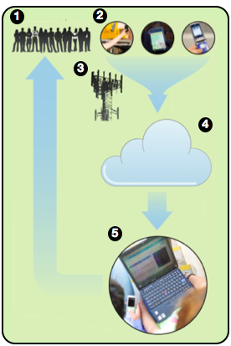
Participatory Sensing (pioneered by Professor D. Estrin)
Real Time (always on)
Real Place (always carried)
Real Context (historical, spatial, environmental, social)
Real Applications (civic and environmental data, transportation, health, education)

Slide 6
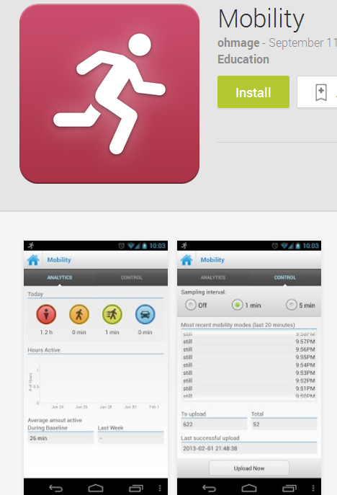
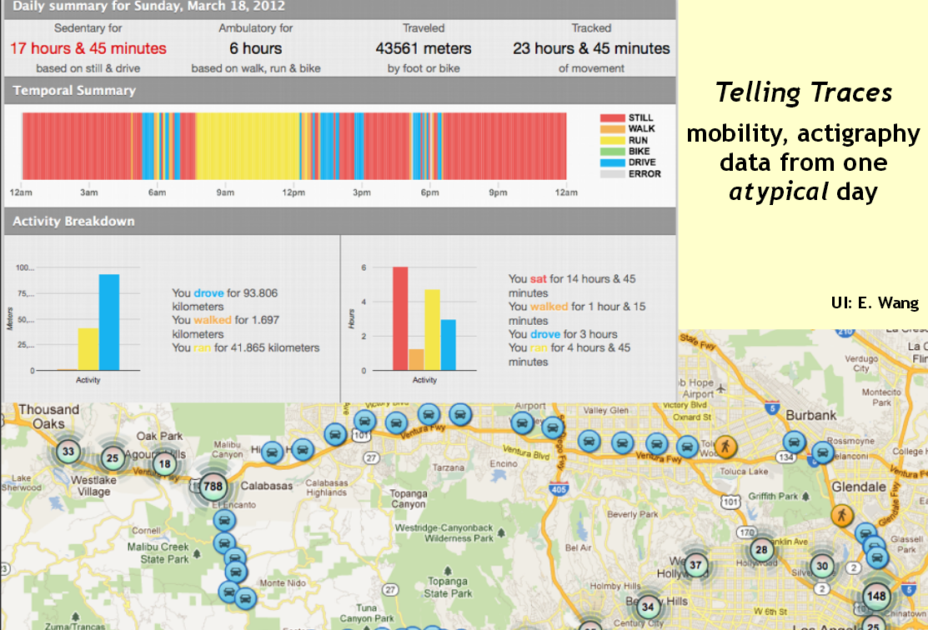
Passive Data Collection

Slide 7
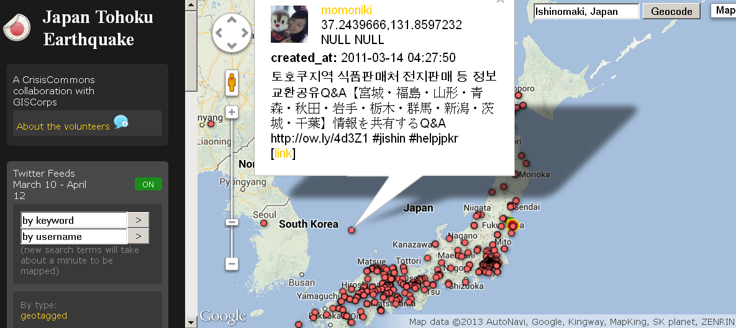
Public Data Collection

Slide 8
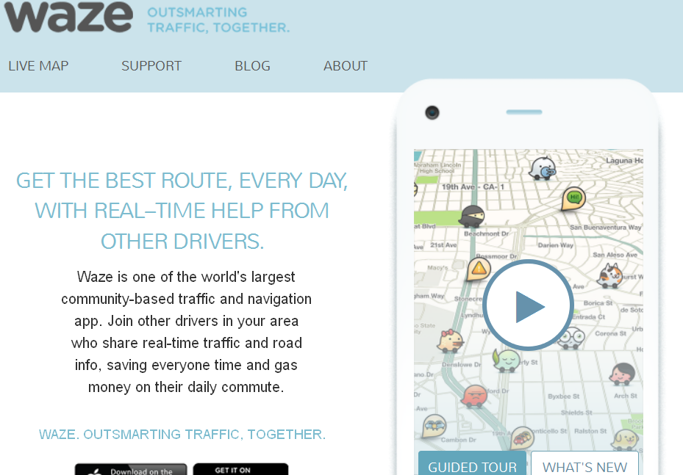
Crowd Sourced MDC

Slide 9
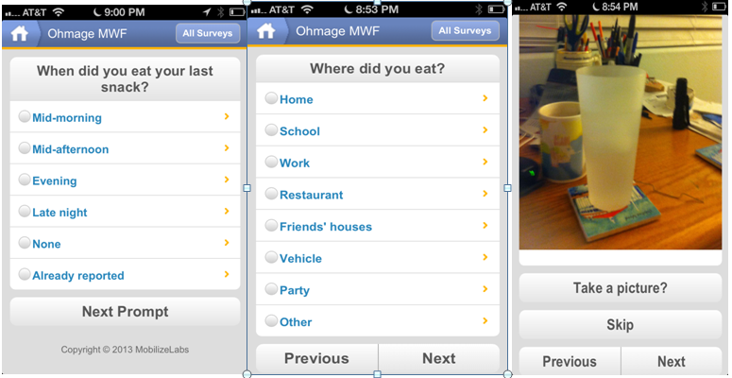
Private MDC

Slide 10
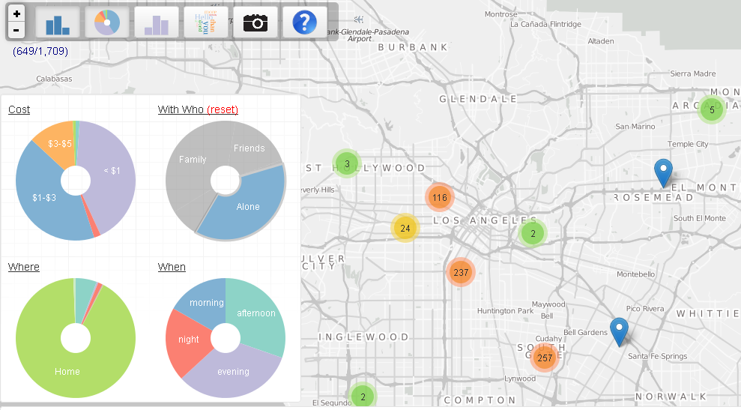
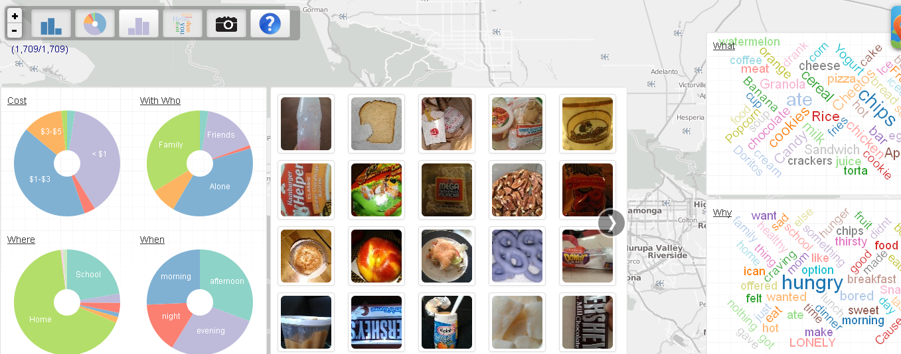
Demo MDC Visualization
https://lausd.mobilizingcs.org/snackdemo/
The Mobilize Project – created by Jeroen Ooms

Slide 11
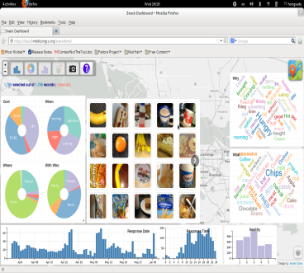
Private MDC Process
Meet with Researcher
Discuss Data, privacy and or security rqmts
IRB required for Research
Integrated and iterative
Create Campaign
Collect Data
Analyze Data

Slide 12
(Example) Private Mobile Data Collection
Using ohmage MWF
Available free :
Ios App Store
The Android Google Play market

Slide 13
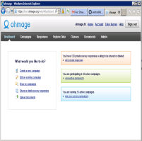
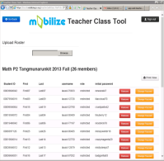
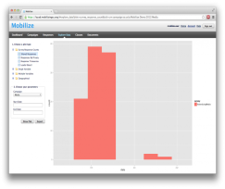
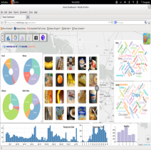
Ohmage Mobile-to-Web Platform
Mobile Clients
ohmage
ohmage MWF
Mobility
SystemSens
Acoustic
Self-report
Passive Data Streams
Ohmage server (RESTful APIs)
Ohmage FrontEnd
Campaign Authoring
Survey
Gathering
Teacher
Tool
Ohmage
Expore Data
Snackboard
LifeStreams
Data Management and Administration
Visualization and Analysis
Web Applications
Notes:
Automatically time-stamped and geo-coded upon submission

Slide 14
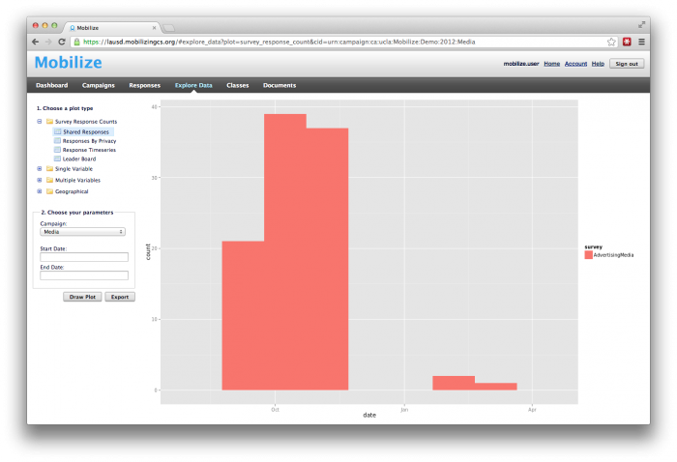
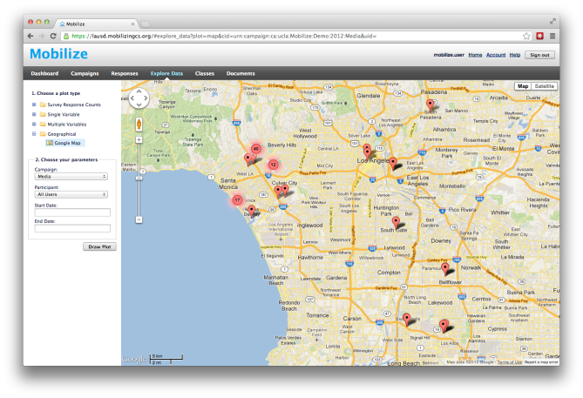
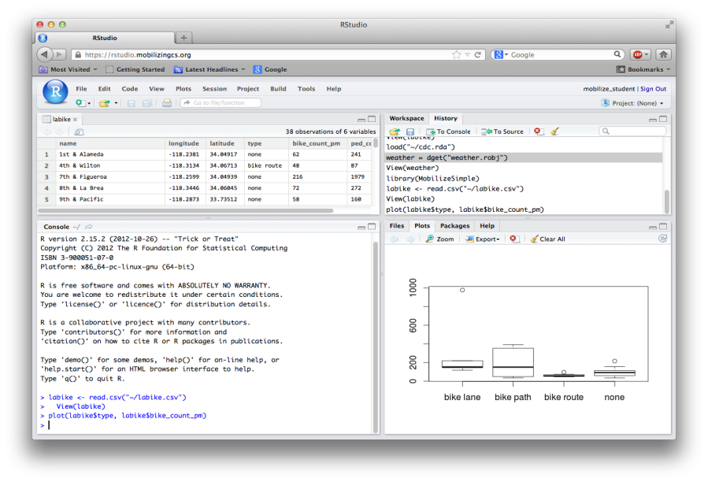
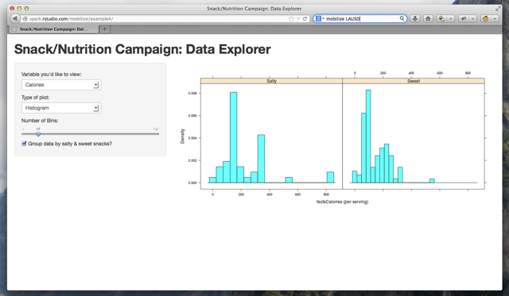
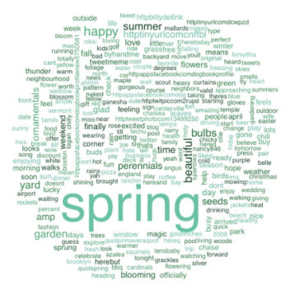
Data Analysis
Different tools for different depths and learning objectives.
Ohmage Generic Data Exploration (all campaigns)
Customized Dashboards: snack, ads, trash
(https://lausd.mobilizingcs.org/snackdemo)
RStudio: Script-based Data Analysis (all campaigns)
Shiny: Customized GUI on RStudio (future)
Notes:
It is extremely difficult to develop a universal data viz that will accommodate for all situations. Therefore, Mobilize provides different tools based on different learning objectives. All tools are built based on data collected by ohmage.
Generic ohmage data exploration: provide a set of plots with limited filtering capability e.g. date, users. There is no filtering based on a response value.
Customized dashboard was originally designed to visualize snack data. The visualization template has then been extended for other campaigns data such as advertisement and trash. It allows users to filter data based on a response values to a set of questions, including a word and location.
Rstudio provides a IDE/scripting environment based on R programming language. Users can apply arbitrary data manipulation or applying different plot functions. Mobilize provides a library of simple commands to ease students from complex tasks.
Shiny is a package that runs on Rstudio. It facilitates the GUI development to support data visualization.

Slide 15
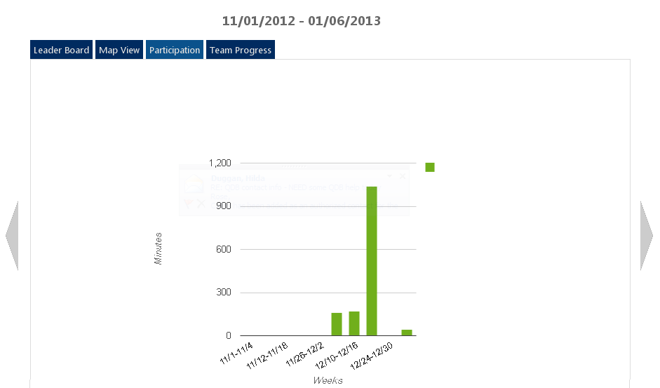
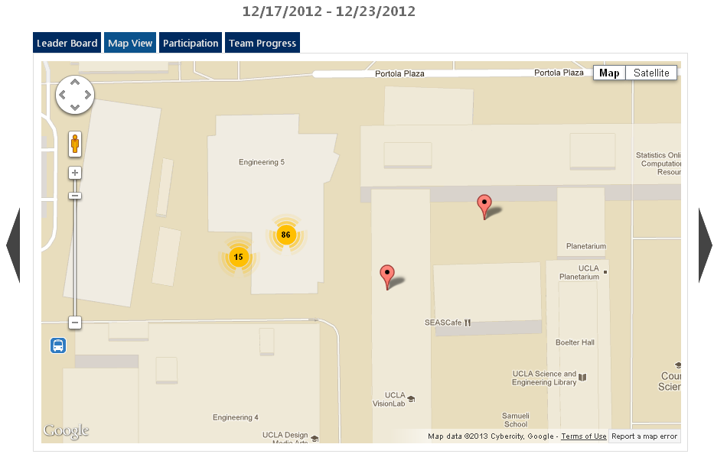
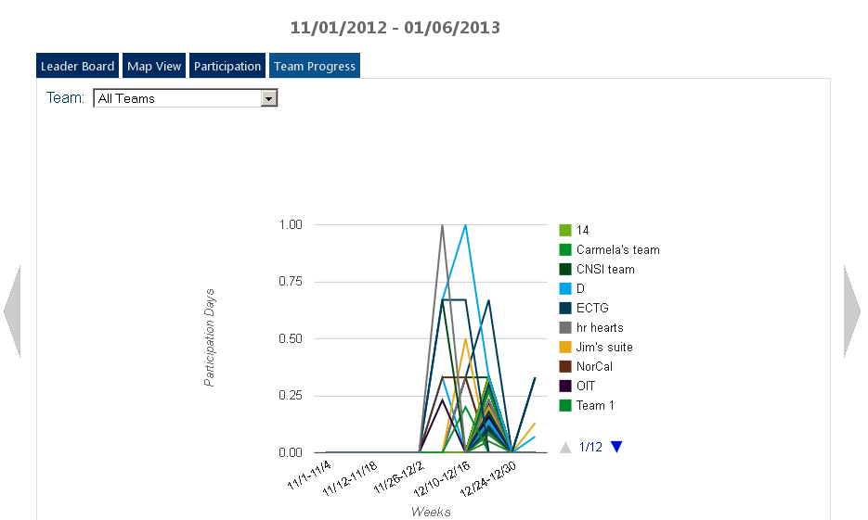
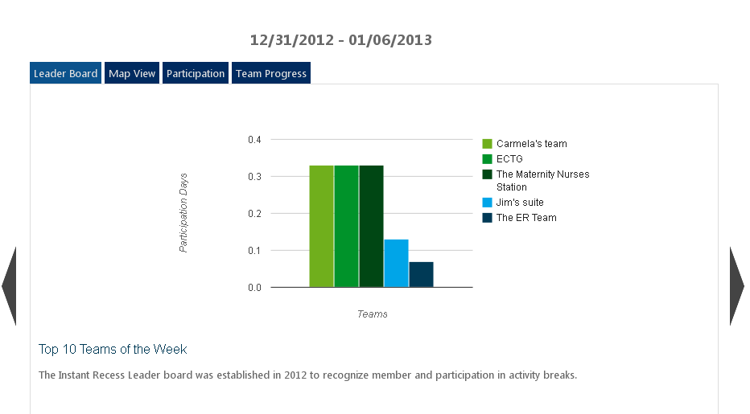
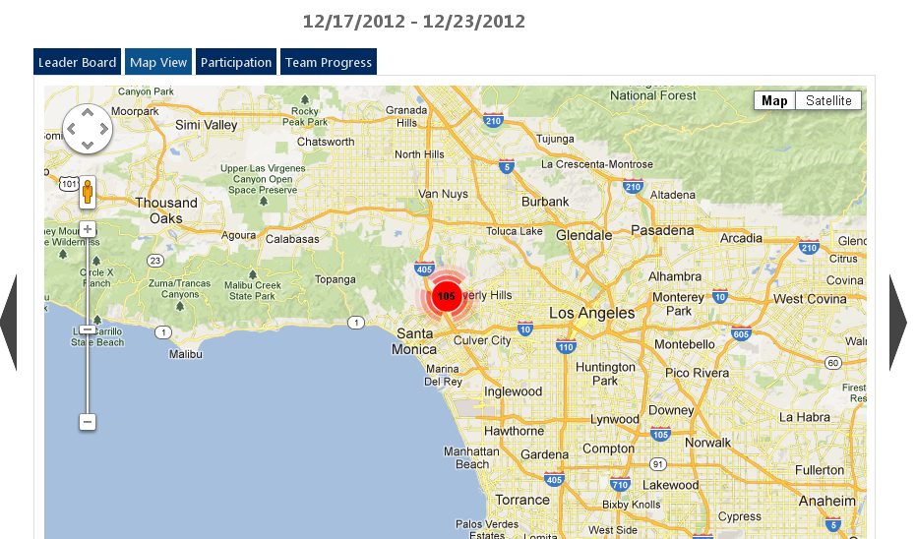
UCLA Health Bruin Break

Slide 16
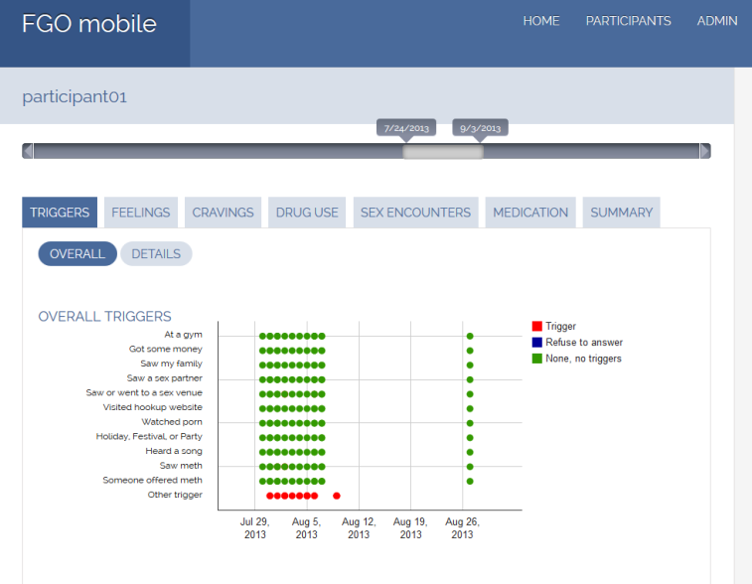
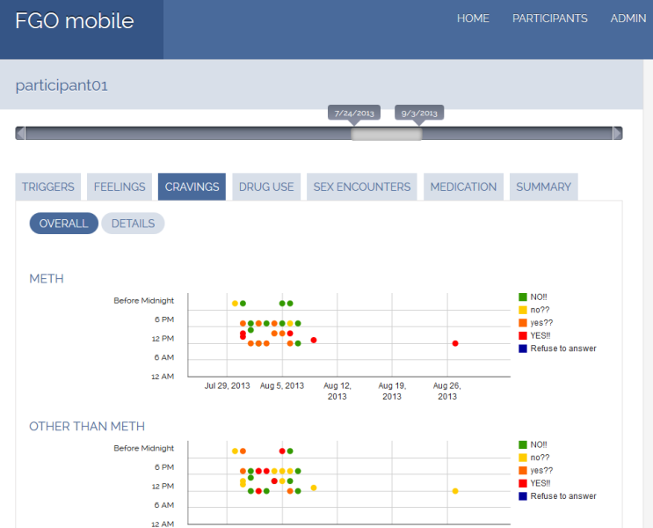
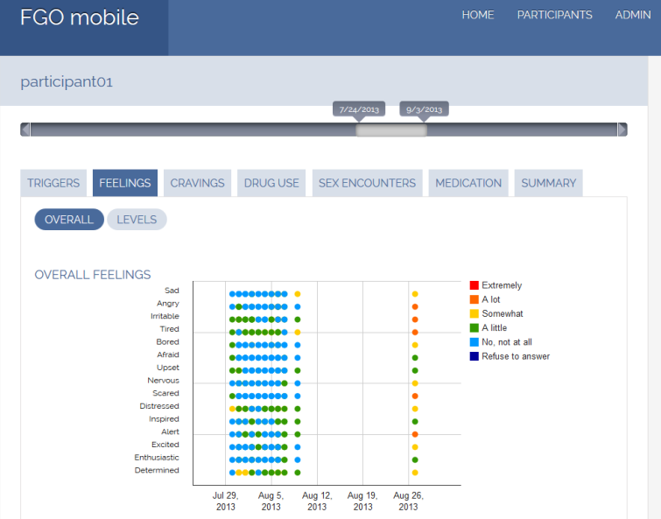
HIV Behavior Study

Slide 17
(Follow-up Project – from Working Title) How a strategy of Responsive Design and Mobile Apps compliment one another

Slide 18
Pending Project Tasks:
Distill seminar content ( 3+ hrs)
Strategic focus as opposed to deep tech
Higher Ed Audience

Slide 19
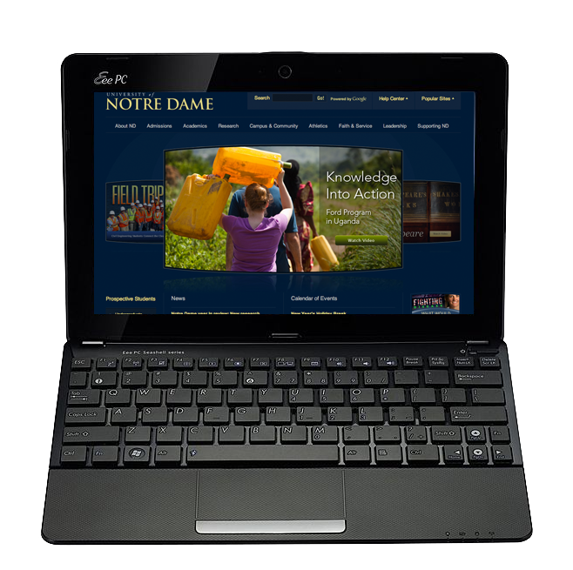
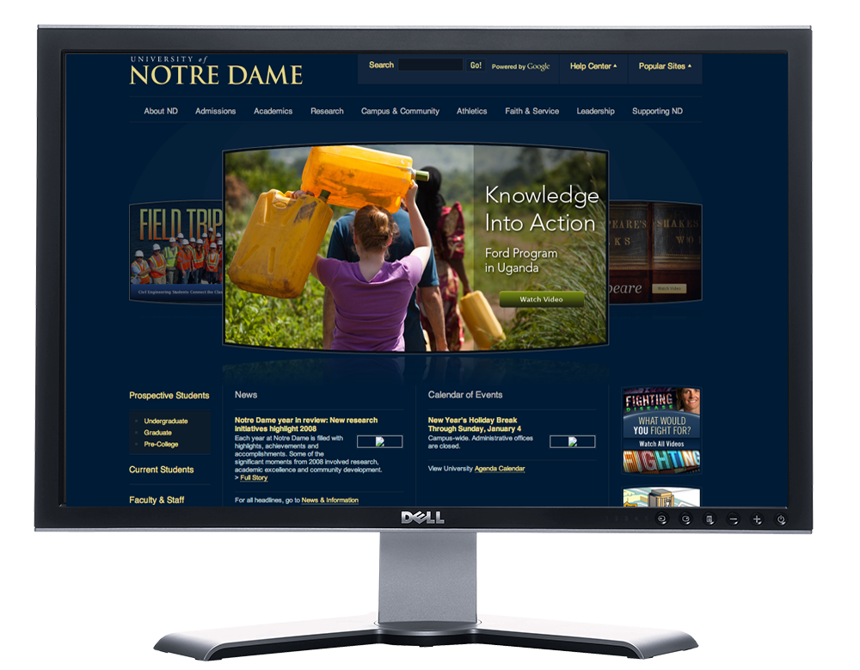
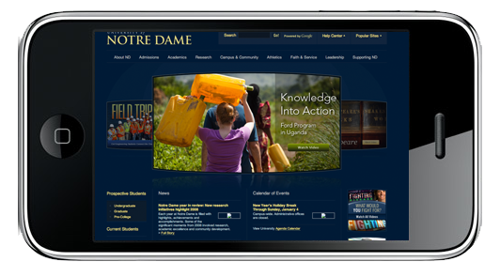
2009

Slide 20
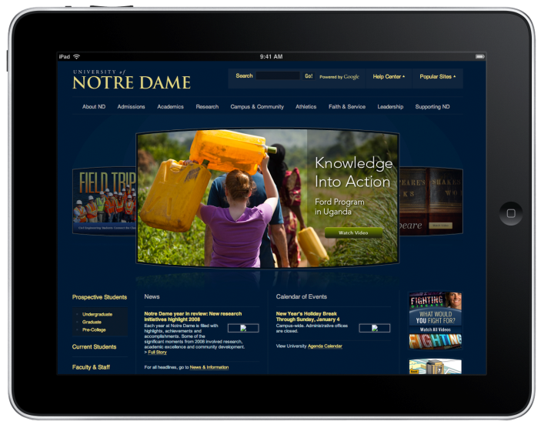
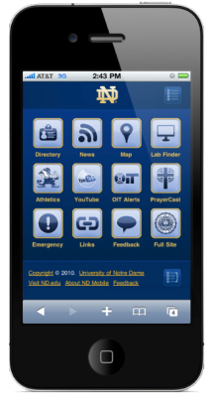
2010

Slide 21
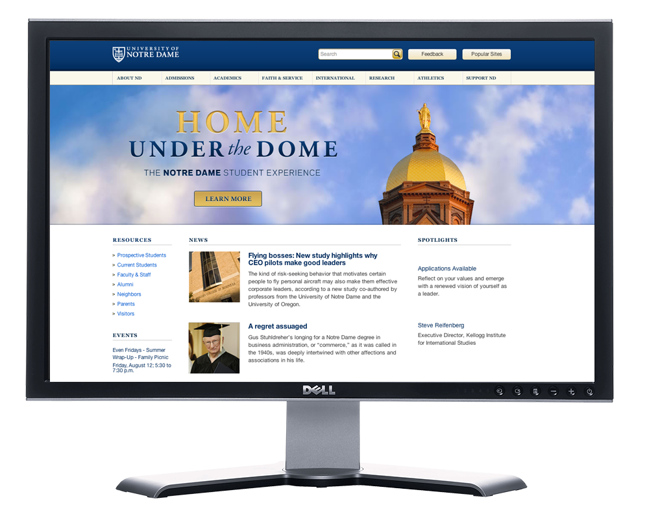
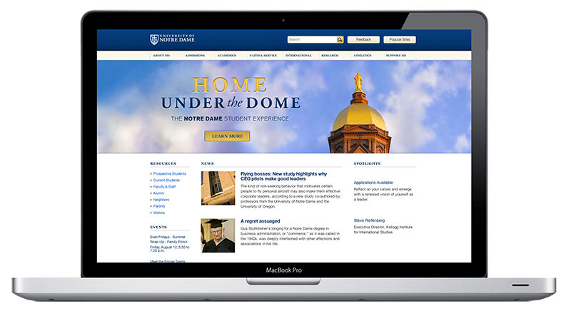
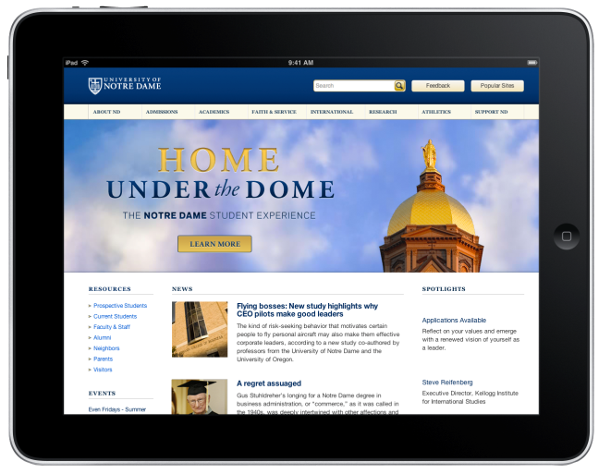
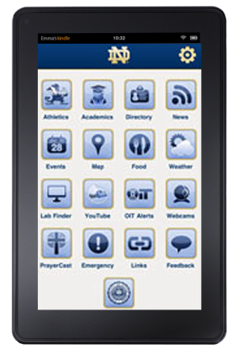
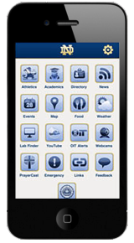
2011

Slide 22
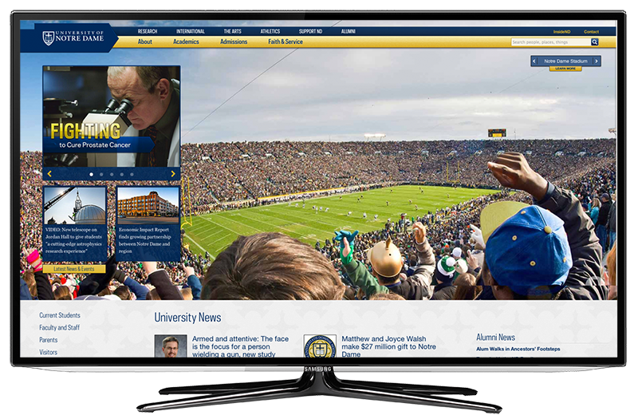
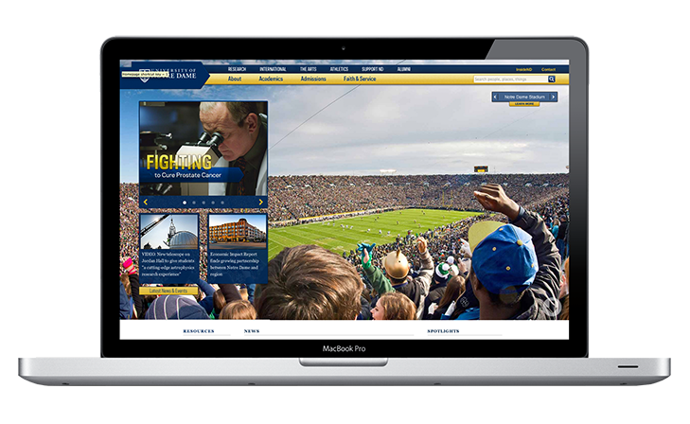
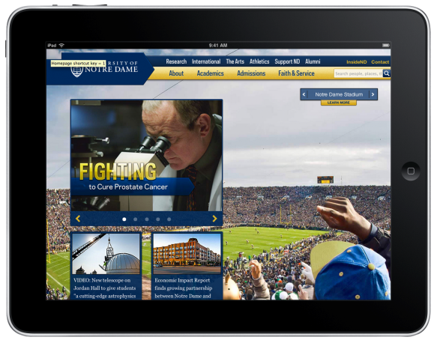
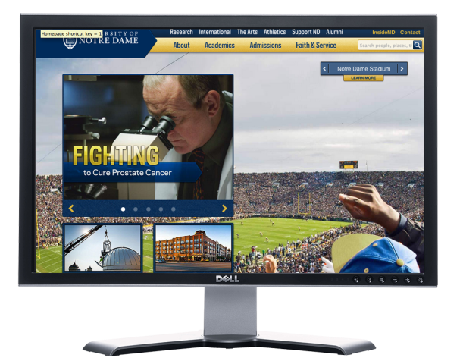
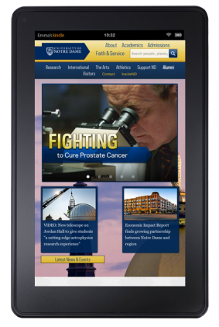
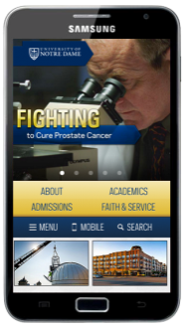
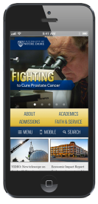
2012

Slide 23
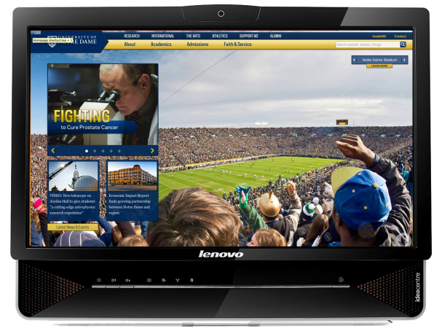
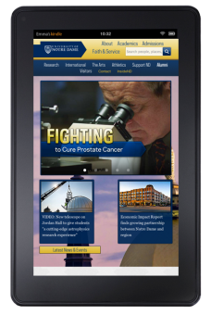
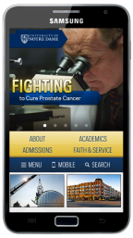
2013

Slide 24
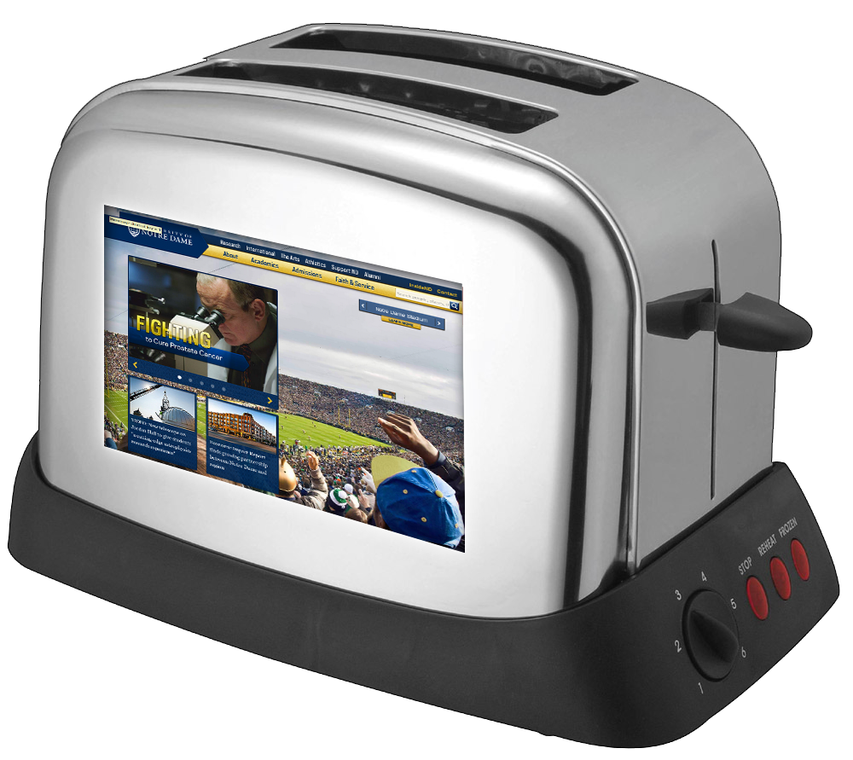
2014

Slide 25
2014 MSAD Planning
Leveraging Social Media to increase Campus Community Connectedness
Explore Better ways to share apps…
Potential mobility review of LMS platforms
Exploration of the “Internet of Things” and how it will impact higher ed

