Slide 1
A Leading Change Culture That Works
Sherri Parker
Dean of Instructional and Learning Resources
@sherri_parker
Copyright Sherri Parker 2014. This work is the intellectual property of the author. Permission is granted for this material to be shared for non-commercial, educational purposes, provided that this copyright statement appears on the reproduced materials and notice is given that the copying is by permission of the author. To disseminate otherwise or to republish requires written permission from the author.

Slide 2
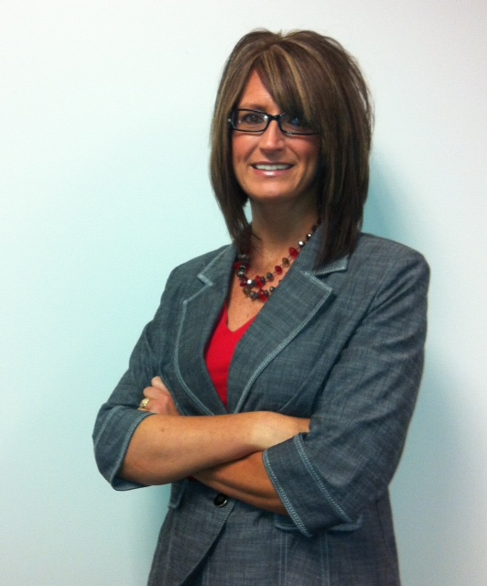
Subject Matter Expertise
Dean of Instructional & Learning Resources
Libraries + Instructional Development + Ed Tech Teams
20 years in Higher Ed – 18 years managing
2013 EDUCAUSE Leading Change Institute Fellow
DePauw University 1994-2012
Notes:
LCI (Formerly Frye Leadership Institute) – Opportunity to focus on challenges that face higher education. Goal is to prepare and develop next generation leaders of libraries and information services to inspire, advocate, and advance change to benefit higher education. Heard from leaders such as the CEO for Educause, Molly Brand, President American Council on Education, Judith Eaton, President for Council for Higher Education Accreditation, Richard Culatta, Deputy Director for the US Office of Educational Technology.

Slide 3
A Leading Change Culture that Works
2014 The Indianapolis Star Top Workplaces
Promotes and supports faith, family, health, work
Highly collaborative cross-functionally
Status equality
Our “WHY” is very clear - focus on serving students in everything we do
Ideas welcomed and seriously heard
Accountability
Competency-based assessment

Slide 4
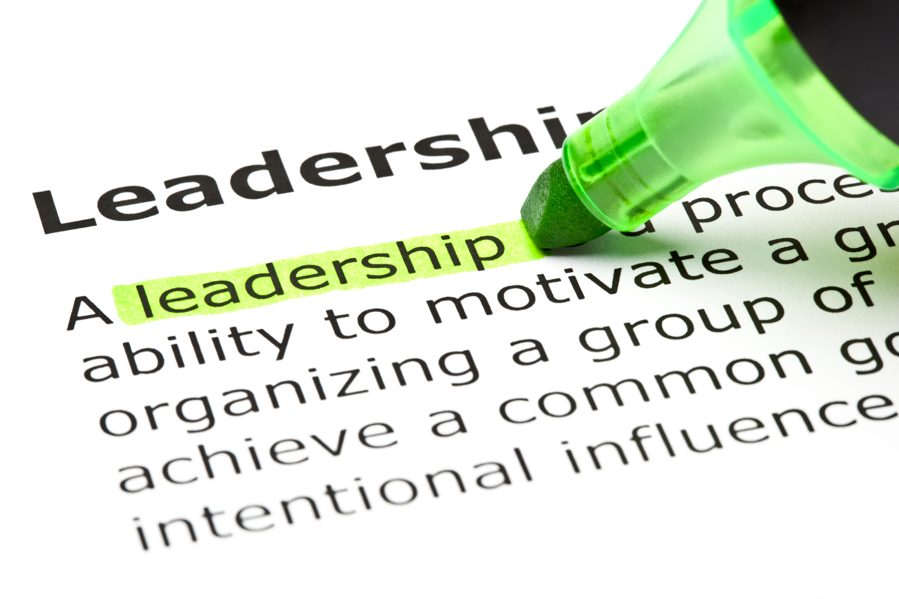
Presentation Objectives
Investigate a distributed leadership model
Identify new processes to define leadership and integrate it into the workplace
Explore competency-based performance evaluation process

Slide 5
Stand Up Poll
You think your institution currently practices and embraces distributed leadership
You feel your current employee performance review process is effective
How do I define distributed leadership?
Notes:
Goal = 6 min.

Slide 6
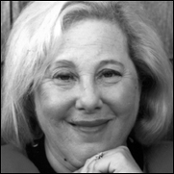
Rosabeth Moss Kanter
Holds the Ernest L. Arbuckle Professorship at Harvard Business School, where she specializes in strategy, innovation, and leadership for change.
On Twitter and in the Workplace, It's Power to the Connectors. November 16, 2009
http://www.hbs.edu/faculty/Pages/profile.aspx?facId=6486
Notes:
Repeatedly name in the top 50 most powerful women in the world.

Slide 7
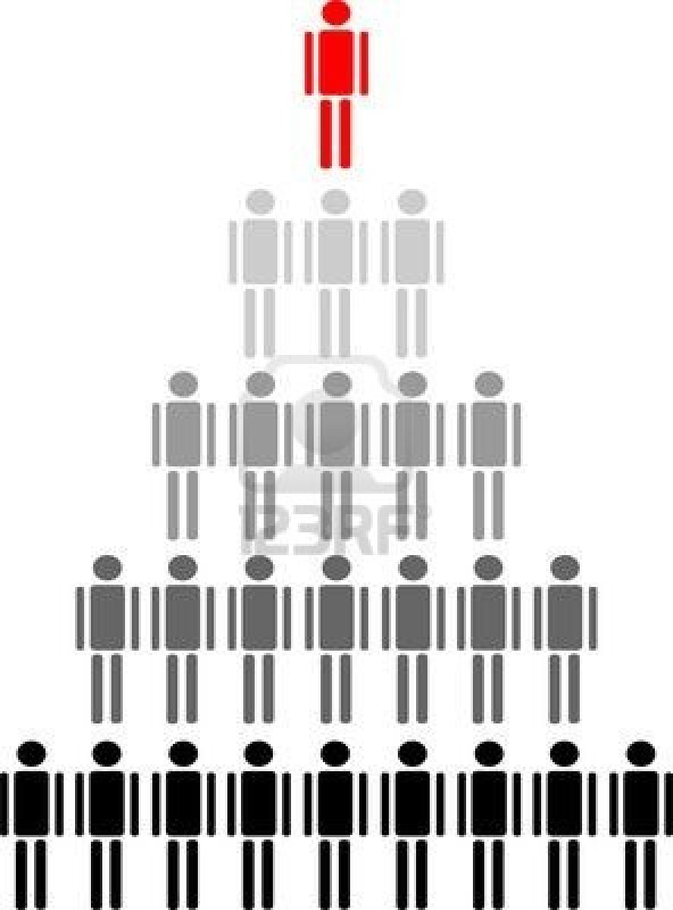
“Society of Organizations”
Formal hierarchies with clear reporting relationships give people their position and power.
Focus:
Top-down approach, managers provide directional leadership
America - 20th Century
People Hierarchy Royalty Free Cliparts, Vectors, And Stock ...
www.123rf.com

Slide 8
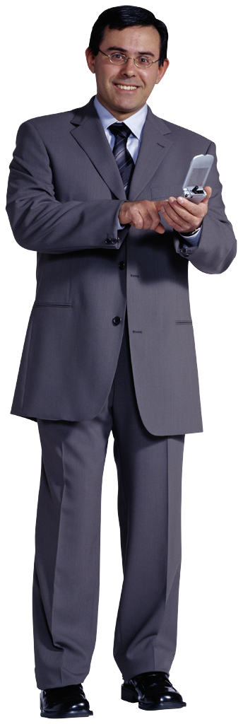
Distributed Leadership
Collective and inclusive philosophy
Shared responsibility
Collaboration
Focus:
Horizontal approach, multi-directional responsibilities
21st Century

Slide 9
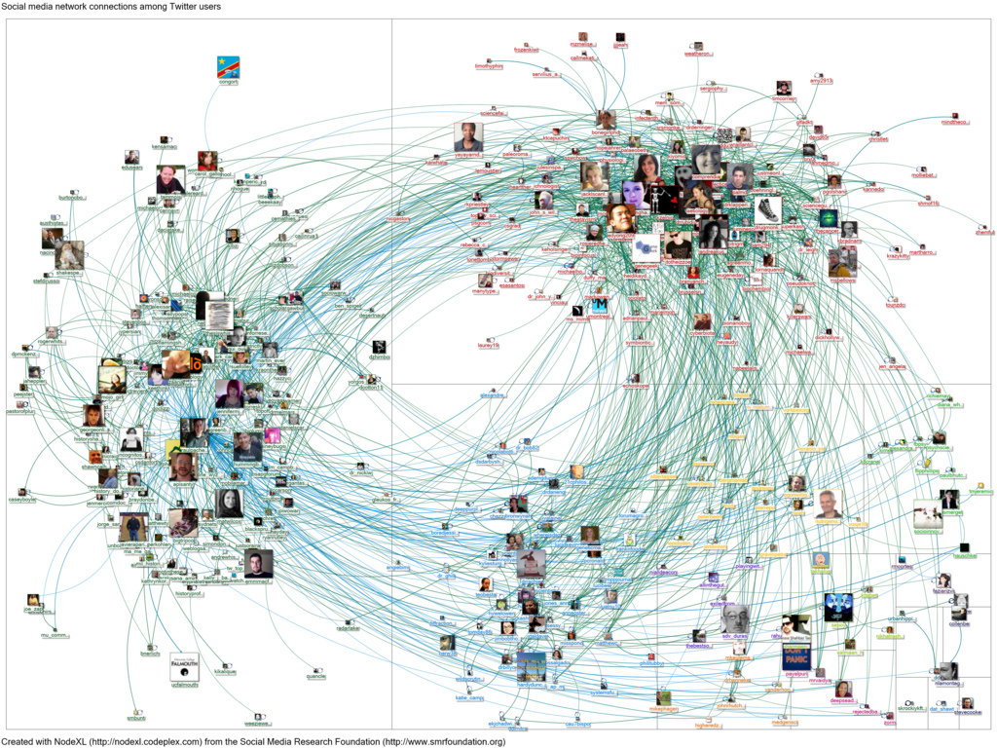
“Society of Networks”
Power and influence
self-organizing networks
21st Century

Slide 10
Circles of Influence
Replace chains of command
Changes nature of career success
21st Century

Slide 11
R. Kanter – Defines Distributed Leadership
Power goes to the “connectors”
those who actively seek relationships
and then serve as bridges between and among groups.

Slide 12
R. Kanter
Increased emphasis on horizontal relationships as the center of action
Result = increased focus on serving customers.

Slide 13
Society of Networks
Fewer people act as power holders monopolizing information or decision-making

Slide 14
R. Kanter - Distributed Leadership
Spanning boundaries
grows relationships
Increasing one’s influence.

Slide 15
Competency-based Performance Assessment
10 competencies – choose 5
Leadership
one shared by every employee

Slide 16
10 Competencies at Harrison College
Leadership (all)
Adaptability (management)
Talent Development (management)
Alignment
Collaboration
Communication
Professional and Technical Expertise
Results Orientation
Service Orientation/Client Focus
Resilience
Notes:
2:26 – total now = say 33 minutes.

Slide 17
Explore Principles
Leadership
Increase your Influence
Notes:
As we begin to explore leadership today, I encourage you to focus on How you can Increase Your Influence. So much about leadership boils down to this overarching theme and the importance of relationship building.

Slide 18
5 Principles of Leadership
Focus on the situation, issue, or behavior, not on the person
Maintain the self-confidence and self-esteem of others
Maintain constructive relationships
Take initiative to make things better
Lead by example
Notes:
10:30.
1. How do we avoid letting personality differences keep us from dealing with a problem?We should broaden our perspective. In order to increase your influence, it is important to remain objective. As a leader, you should also avoid putting others on the defensive. We can also benefit by concentrating on the big picture and considering others’ points of view with an open mind.

Slide 19
Leadership at Harrison College
The ability to make things happen by encouraging and channeling the contributions of others;

Slide 20
Leadership at Harrison College
taking a stand on and addressing important issues;
Houston, we have a problem

Slide 21
Leadership at Harrison College
acting as a catalyst for change and continuous improvement;

Slide 22
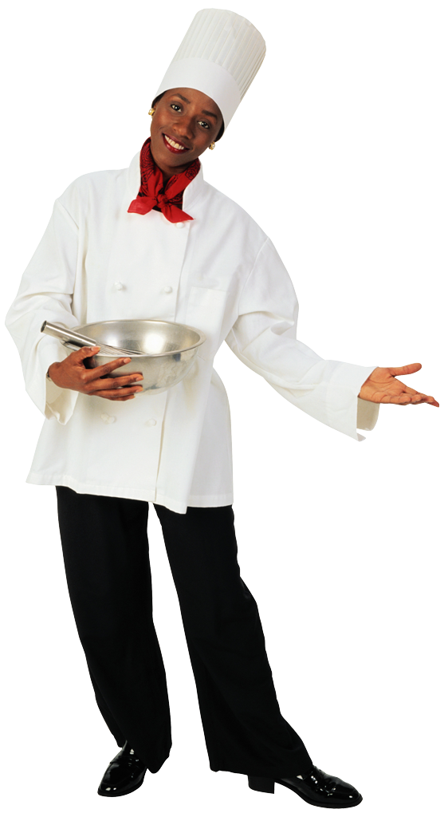
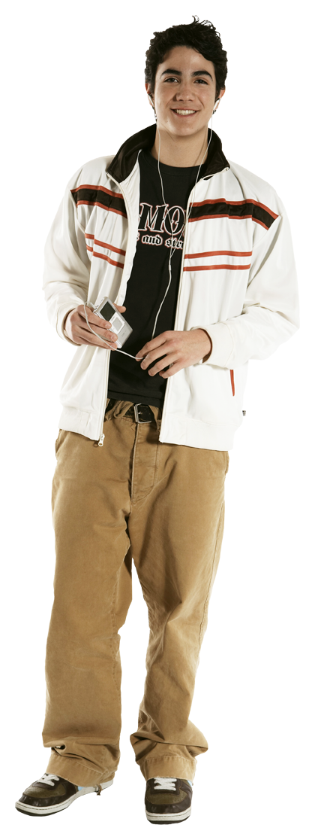
Leadership at Harrison College
developing viable partnerships and networks of people.
Notes:
10:55 – 30 minutes total is goal!

Slide 23
Interactive Brainstorm Session
In 8 minutes, each group must:
Review group assignment
Brainstorm / discuss
Identify scribe
Identify facilitator(s) to share group results with larger group
Provide a 3-minute presentation to share findings

Slide 24
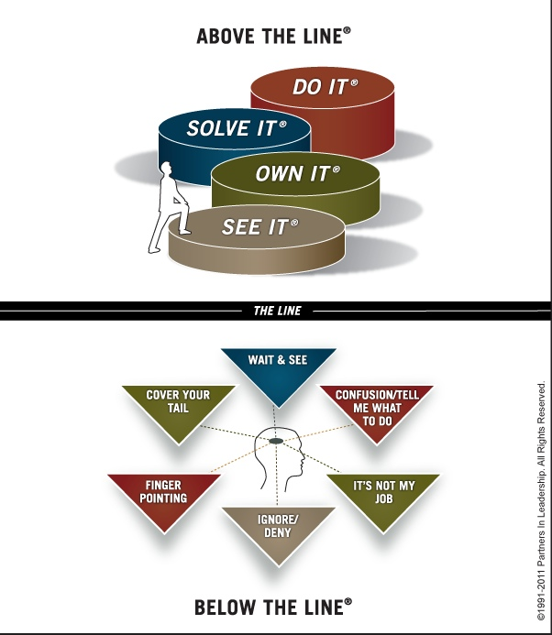
Item for Your Tool Belt
STEPS TO ACCOUNTABILITY®
Roger Connors, CEO, Partners of Leadership
The Oz Principle
http://www.ozprinciple.com/self/steps-to-accountability/
Notes:
Roger Connors created the Steps to Accountability Chart – describes this concept in his NY best seller, “The Oz Principle”.

Slide 25
Item for Your Tool Belt
15Five – great alignment/communication tool
What’s going well in your role? Any big wins this week?
What challenges are you facing? How are you going to fix and where do you need help?
How are you feeling? What are you doing to build morale and performance?
Good idea - what one thing will make the biggest improvement in your job, your team, or the organization?

Slide 26
A Leading Change Culture that Works
THANK YOU!
Questions?
Sherri Parker
Dean of Instructional and Learning Resources
Harrison College
sherri.parker@harrison.edu 317-447-6085

Slide 27
Cited Sources
123RF Royalty Free Stock Photos. (3 August 2013). Retrieved from http://us.123rf.com/400wm/400/400/costa1980/costa19800609/costa1980060900029/547570-people-hierarchy.jpg.
15Five. (3 August 2013). Retrieved from 15Five.com.
Diaz, J. 20 November 2012. Harrison College Fall Leadership Conference Presentation.
Kanter, Rosabeth Moss. 2009 November 16. On Twitter and in the Workplace, It’s Power to the connectors. Harvard Business Review. Retrieved from http://blogs.hbr.org/kanter/2009/11/power-to-the-connectors.html
Harvard Business School. Faculty & Research. (3 August 2013). Rosabeth M. Kanter. Retrieved from http://www.hbs.edu/faculty/Pages/profile.aspx?facId=6486.
Harrison College. 2013 August 1. Harrison Competencies.
Partnership in Leadership. (3 August 2013). Steps to Accountability. Retrieved from http://www.ozprinciple.com/self/steps-to-accountability/.
Social Media Research Foundation. (3 August 2013). Social Media Connectors Among Social Media Users. Retrieved from http://farm8.staticflickr.com/7003/6704337077_ef78832961_b.jpg.

