Slide 1

Our Virtualization Story
The Academic vs IT
Viewpoint of the BYOE Revolution
Crista Copp, Director of Academic Technology
Jeff Solomon, Director of Infrastructure
Notes:
Online Education History
Strategies of Online
Technology and Support Systems

Slide 2
Our Story
The Academic
Vs.
The IT Guy

Slide 3


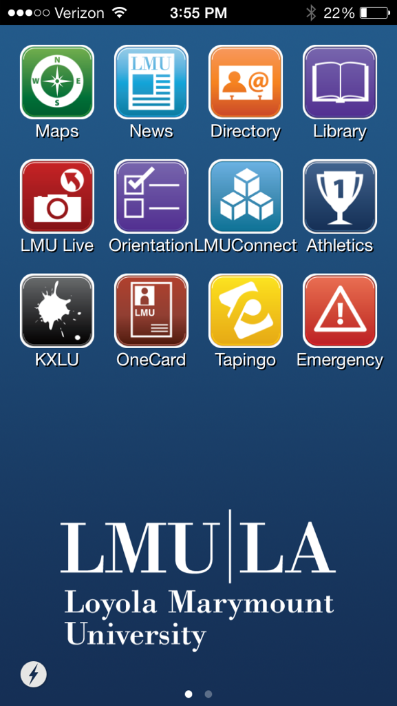
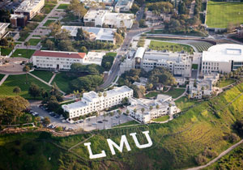



Slide 4

The Train has left the Station…
Notes:
It is impossible to draw a causation, but a sampling of a ten-day period prior to the University of Virginia mess, Google indexed approximately 60 million articles instances that include “Online Education”. In a ten day period immediately following the release of that email, that number went up by 1/3 to 80 million.

Slide 5
Table Talk
Let’s Find Out About You!
Share with Your Colleagues
At Your Table
Notes:
It is impossible to draw a causation, but a sampling of a ten-day period prior to the University of Virginia mess, Google indexed approximately 60 million articles instances that include “Online Education”. In a ten day period immediately following the release of that email, that number went up by 1/3 to 80 million.

Slide 6
Our Story
The Academic
Vs.
The IT Guy

Slide 7
Let’s See It - VDI
Use the VMWare Horizon View Client
t_lmu1 -- t_lmu20
Password: XenApp99

Slide 8
Our Story
The Academic
Vs.
The IT Guy

Slide 9

The Mis-Step

Slide 10
Our Story
The Academic
Vs.
The IT Guy

Slide 11
How students use software:

Slide 12
Let’s See It – Software Virtualization
Use the Citrix Receiver Client
t_lmu1 -- t_lmu20
Password: XenApp99

Slide 13
Our Story will Continue…
The Academic
Vs.
The IT Guy

